Slide 1
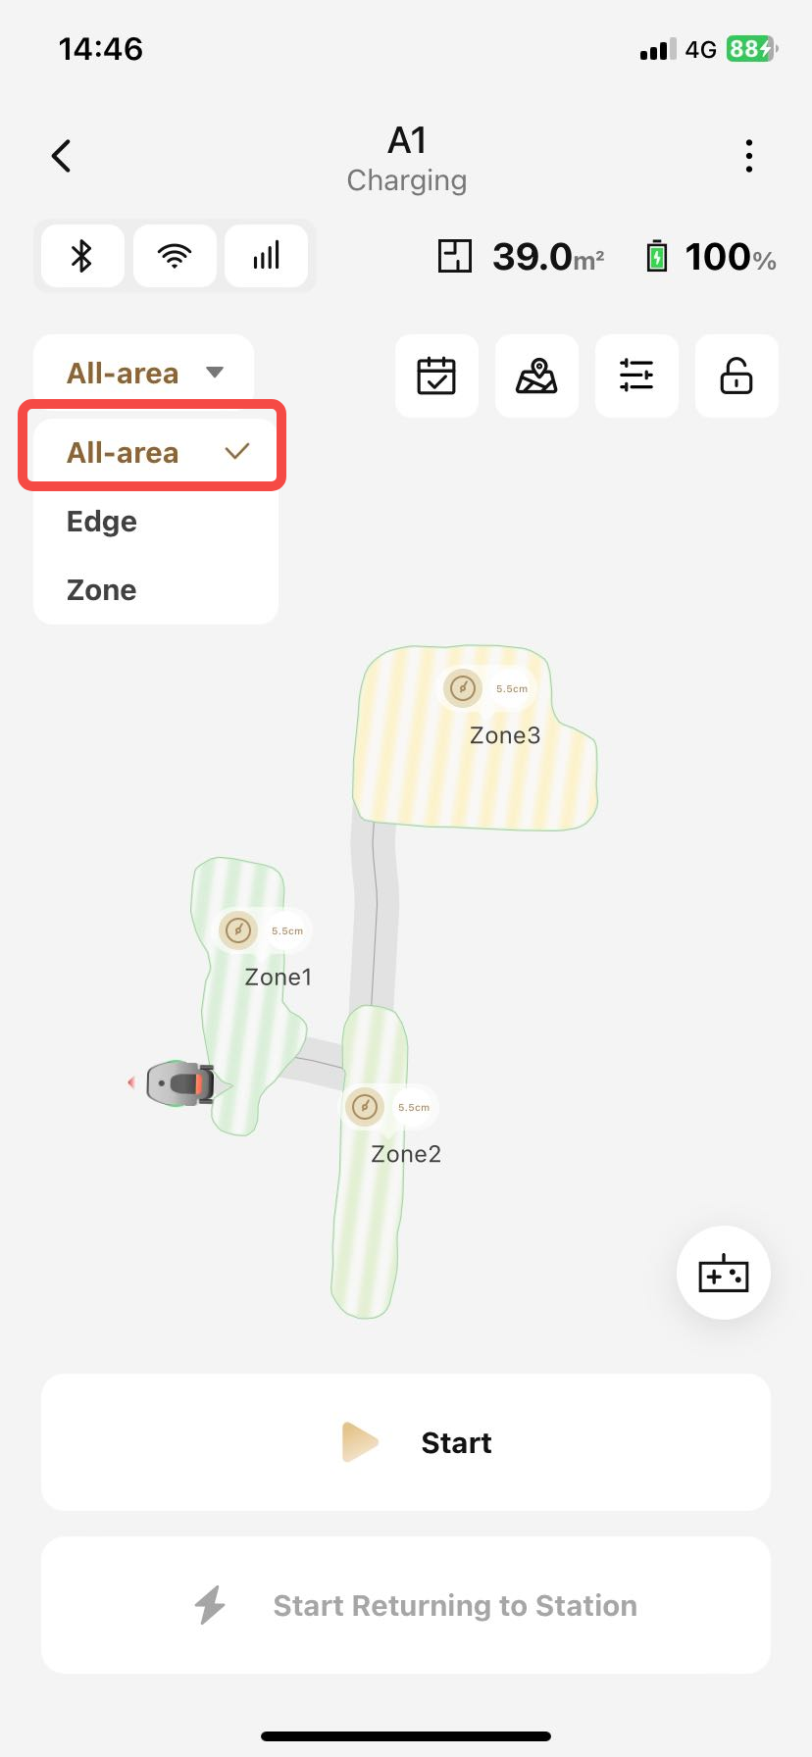
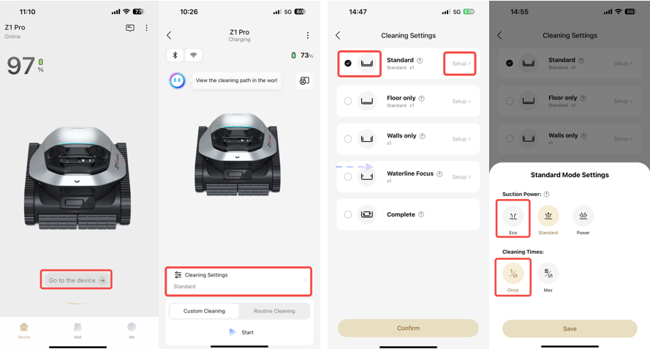
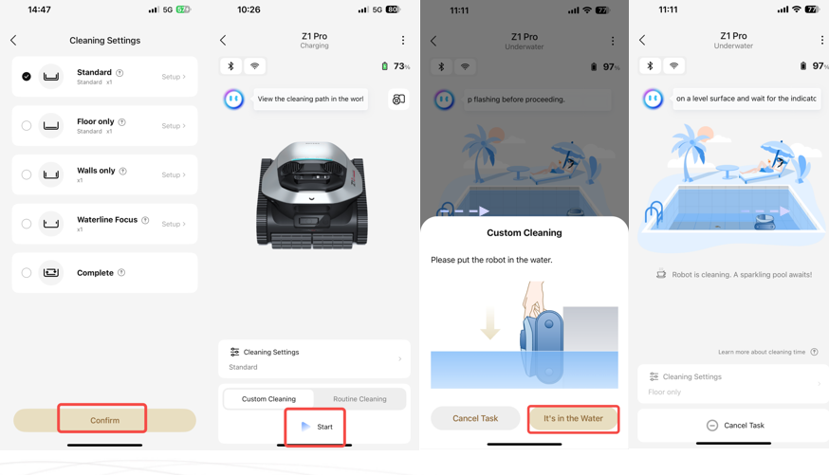
1、启动清洁Activate the cleaning function.
1、启动全局清洁 Initiate global cleaning

Slide 2
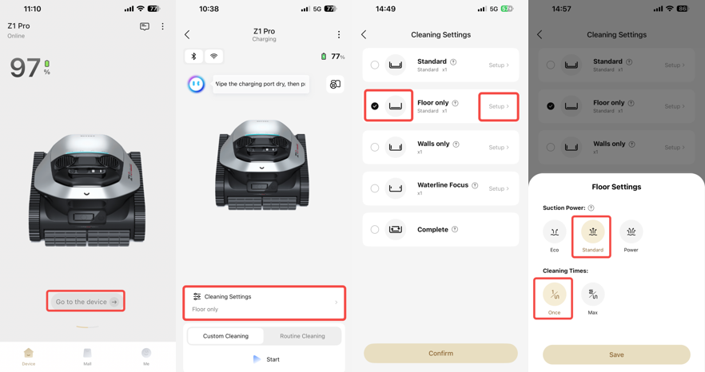
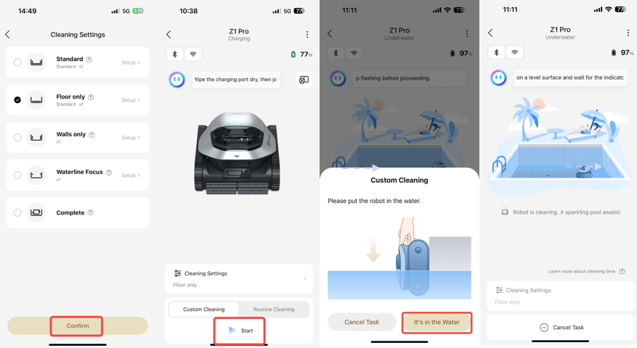
1、启动清洁 Activate the cleaning function.
2、启动池底清洁 Initiate pool bottom cleaning

Slide 3
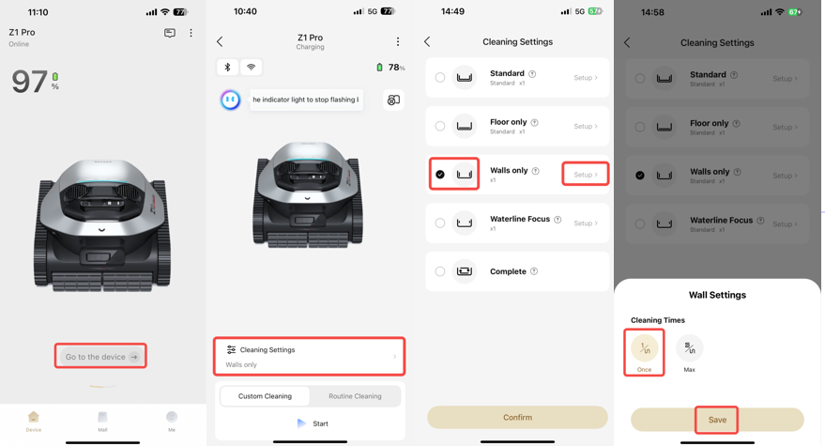
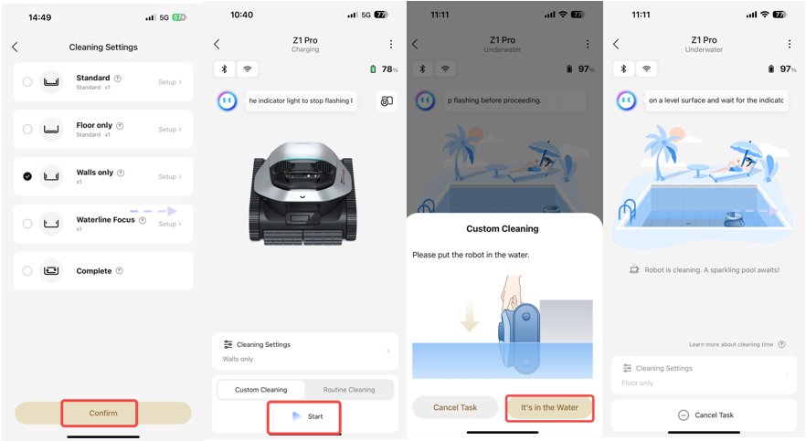
1、启动清洁 Activate the cleaning function.
3、启动池壁清洁 Initiate pool wall cleaning

Slide 4
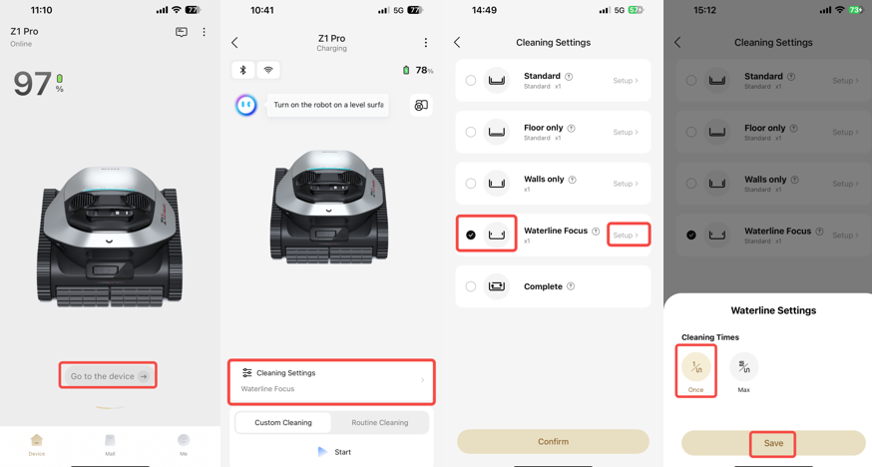
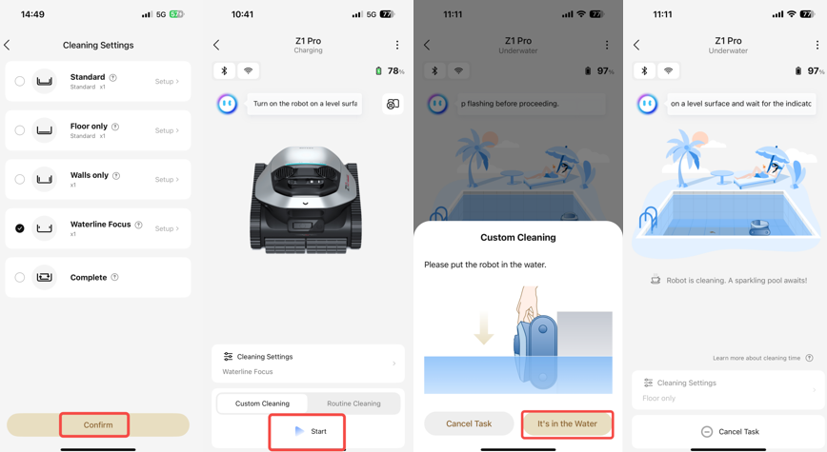
1、启动清洁 Activate the cleaning function.
4、启动高效水线清洁 Activate high-efficiency waterline cleaning

Slide 5
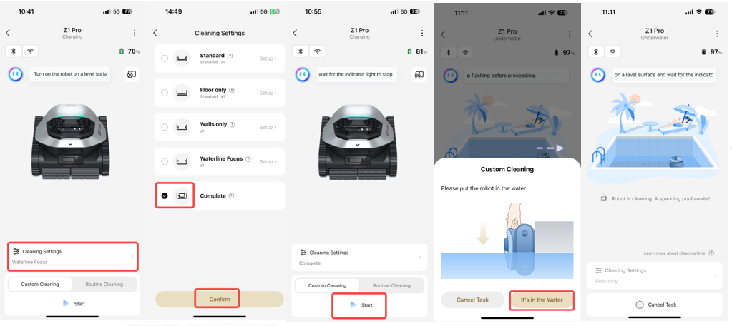
1、启动清洁 Activate the cleaning function.
5、启动全域清洁（此模式下不建图，设备只进行惯导弓字进行清洁）
Activate Complete cleaning（In this mode, the device does not create a map and only performs inertial navigation in a bow-shaped pattern for cleaning.）

Slide 6
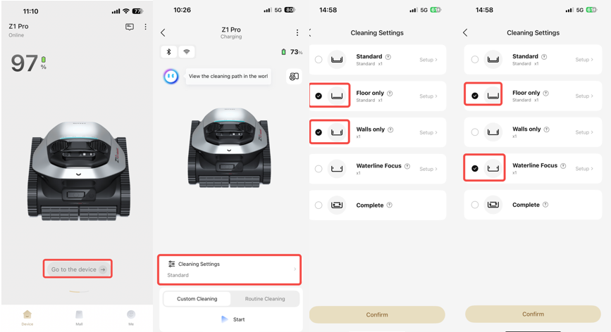
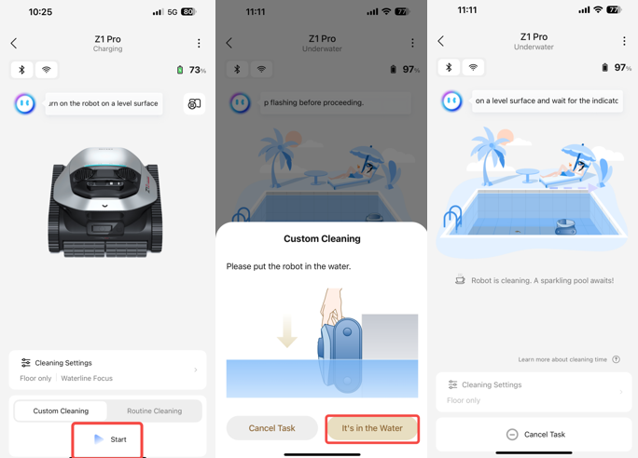
1、启动清洁 Activate the cleaning function.
6、启动自定义清洁 Initiate customized cleaning

Slide 7
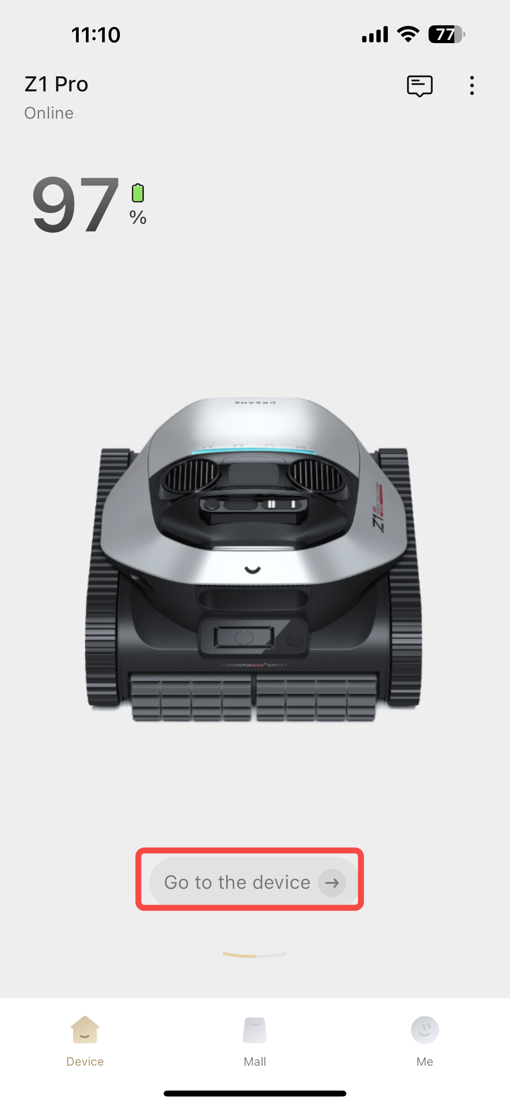
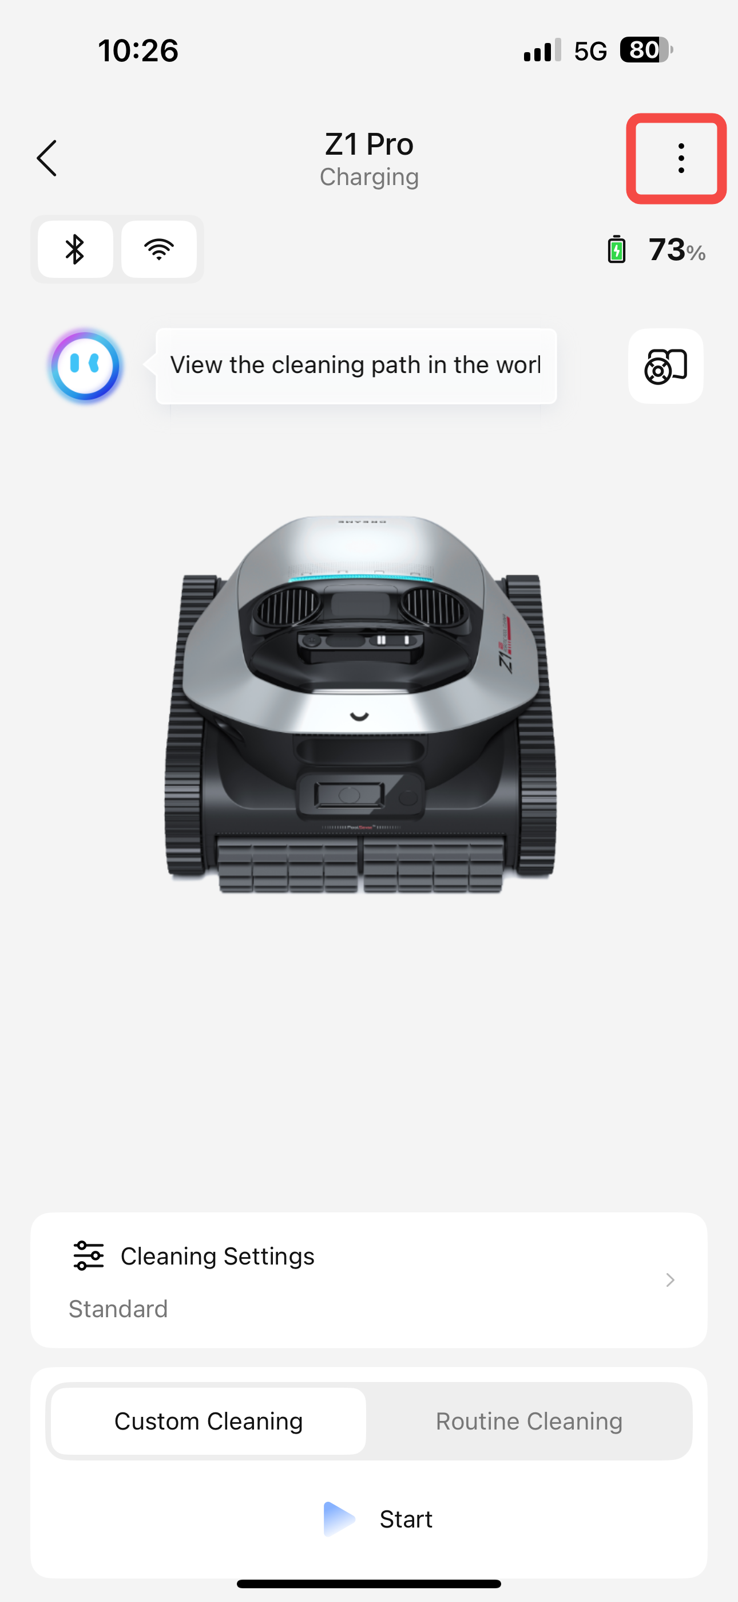
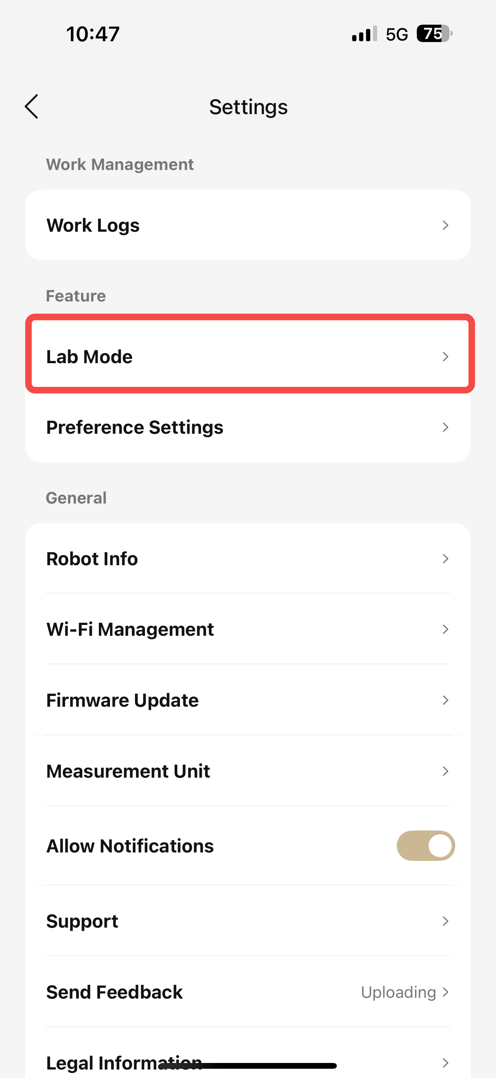
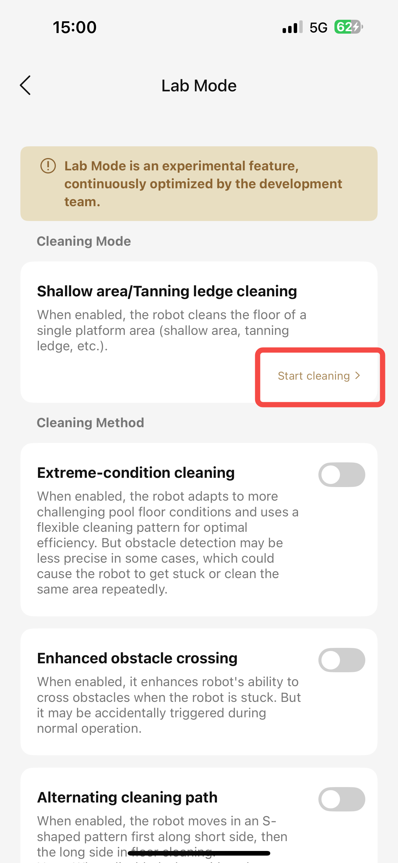
1、启动清洁 Activate the cleaning function.
7、启动浅层/晒黑台清洁——实验室功能（此模式下不建图，设备只进行浅层区域做清洁动作，并避免掉入深水区）
可通过此模式对单个平台区域的池底进行清洁（如浅层/晒黑台）
Shallow area/Tanning ledge cleaning——Lab Mode（In this mode, the device does not create a map and only performs cleaning operations in the shallow areas, while avoiding falling into the deep water area.）
When enabled, the robot cleans the floor of a single platform area (shallow area, tanning ledge, etc.).

Slide 8
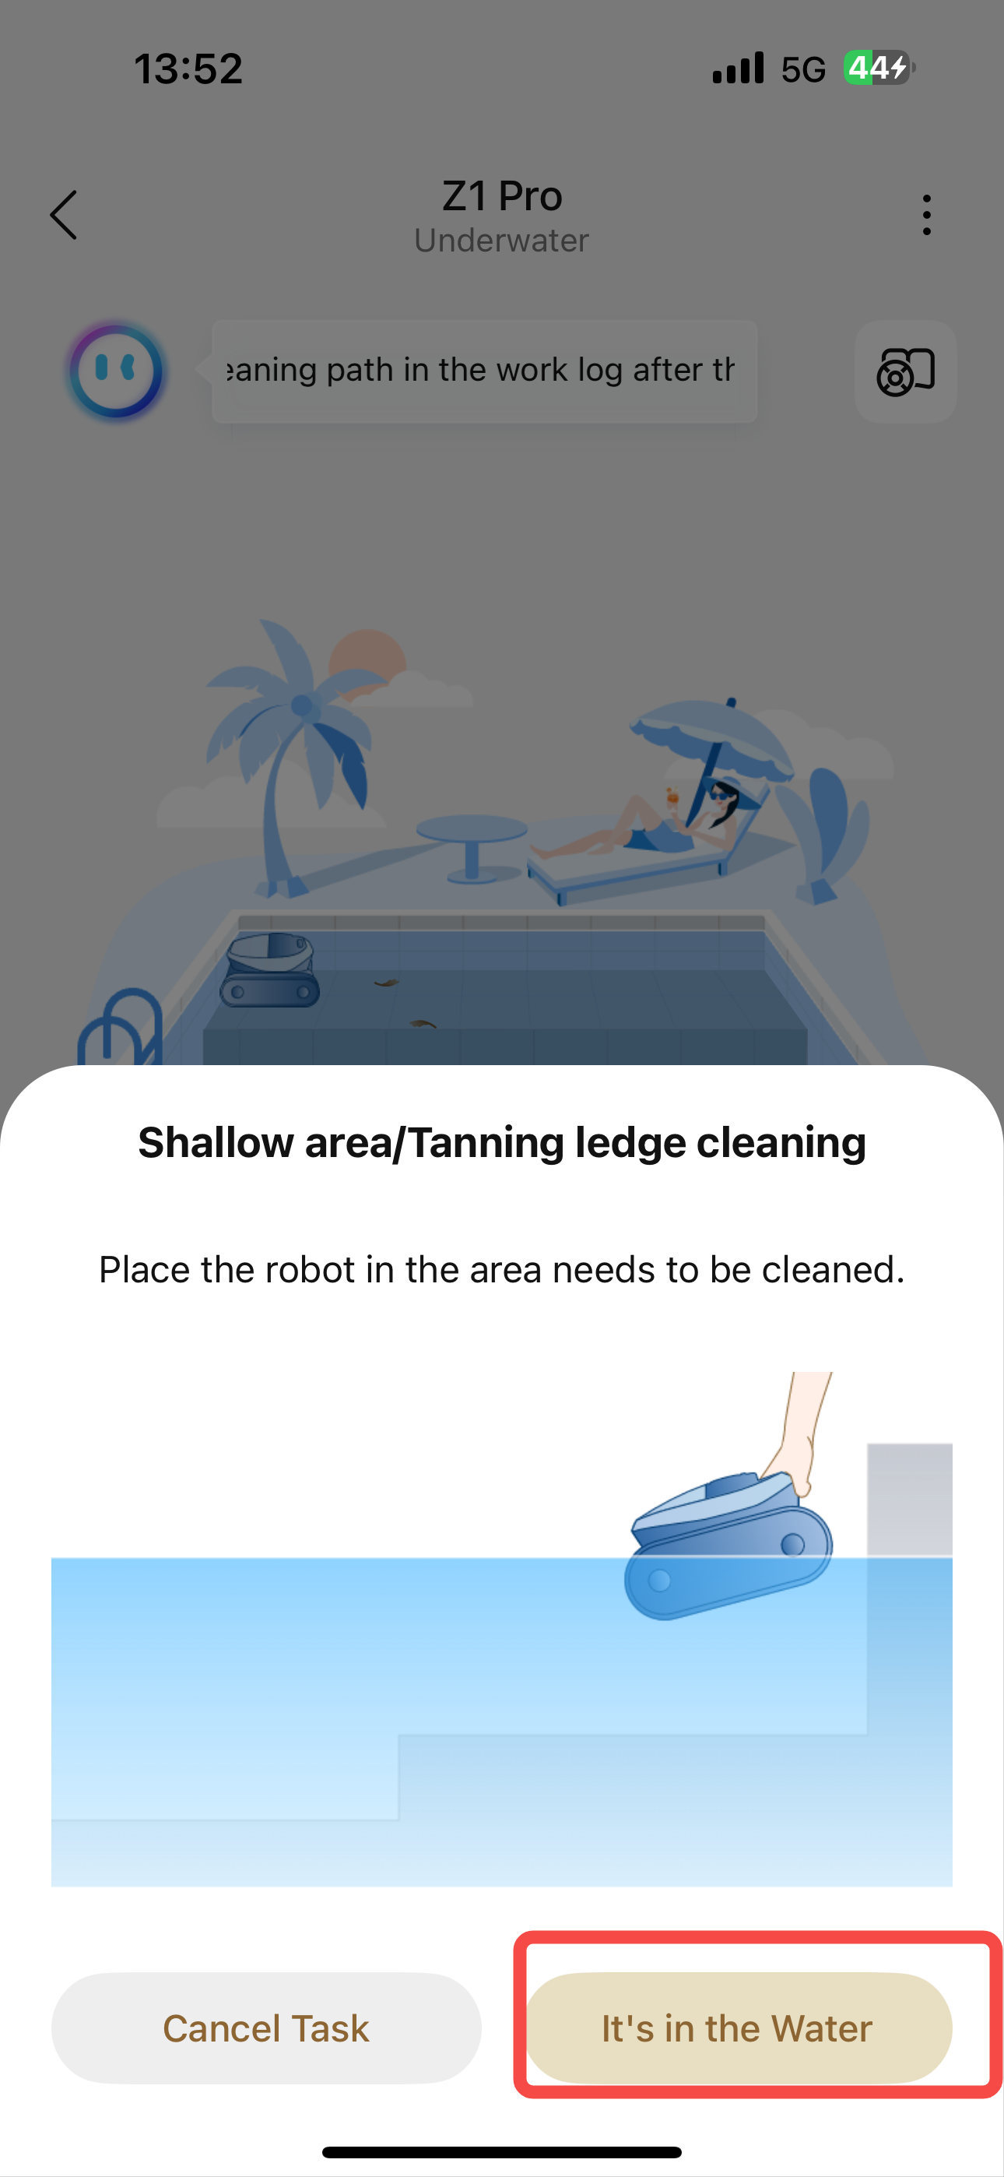
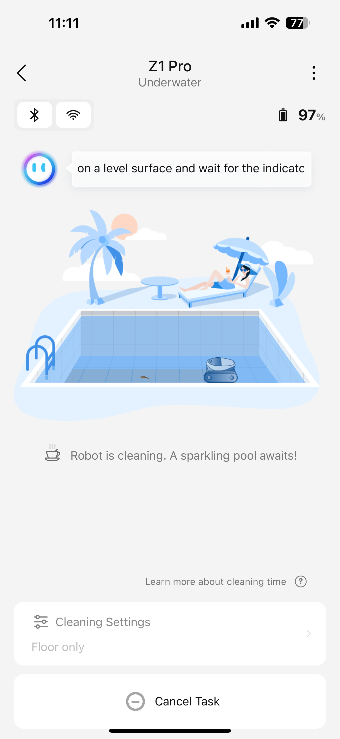
1、启动清洁 Activate the cleaning function.
7、启动浅层/晒黑台清洁——实验室功能（此模式下不建图，设备只进行浅层区域做清洁动作，并避免掉入深水区）
可通过此模式对单个平台区域的池底进行清洁（如浅层/晒黑台）
Shallow area/Tanning ledge cleaning——Lab Mode（In this mode, the device does not create a map and only performs cleaning operations in the shallow areas, while avoiding falling into the deep water area.）
When enabled, the robot cleans the floor of a single platform area (shallow area, tanning ledge, etc.).

Slide 9
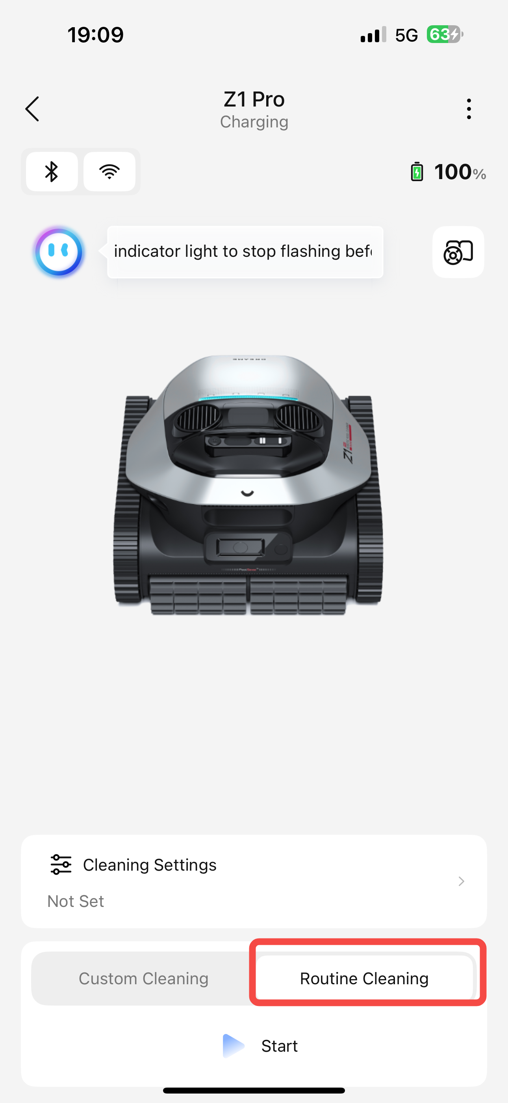
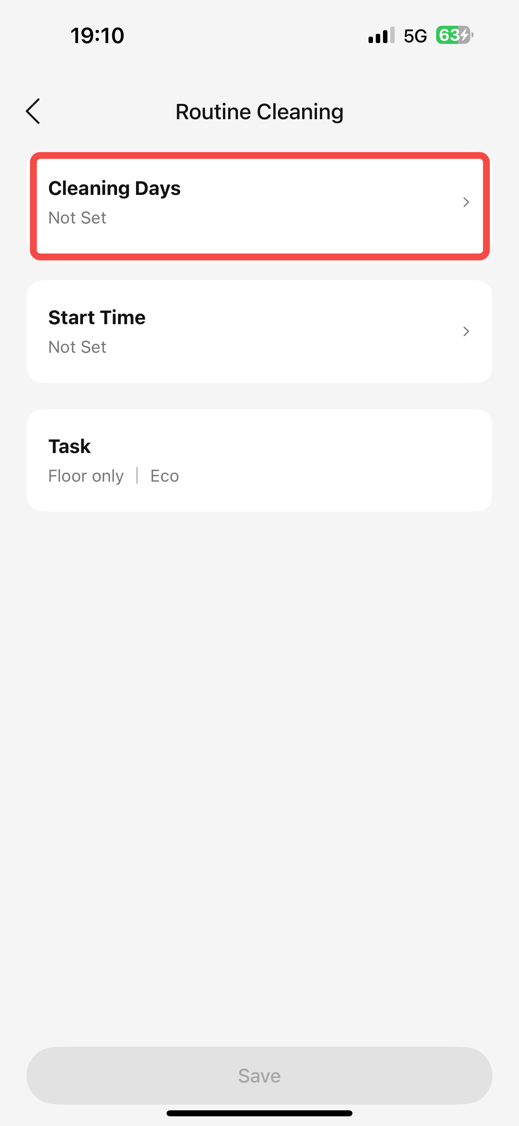
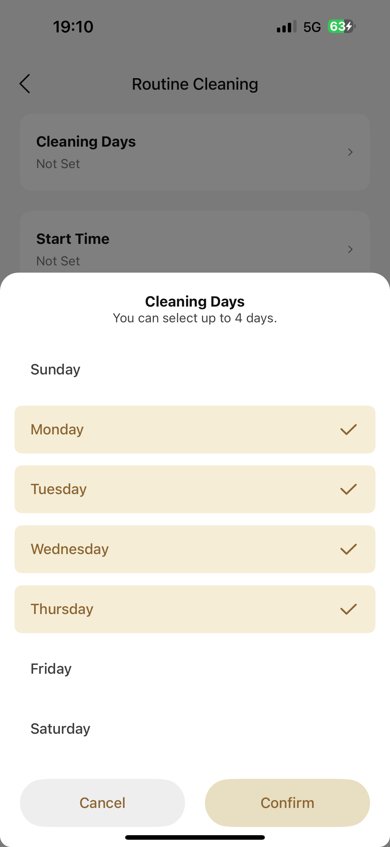
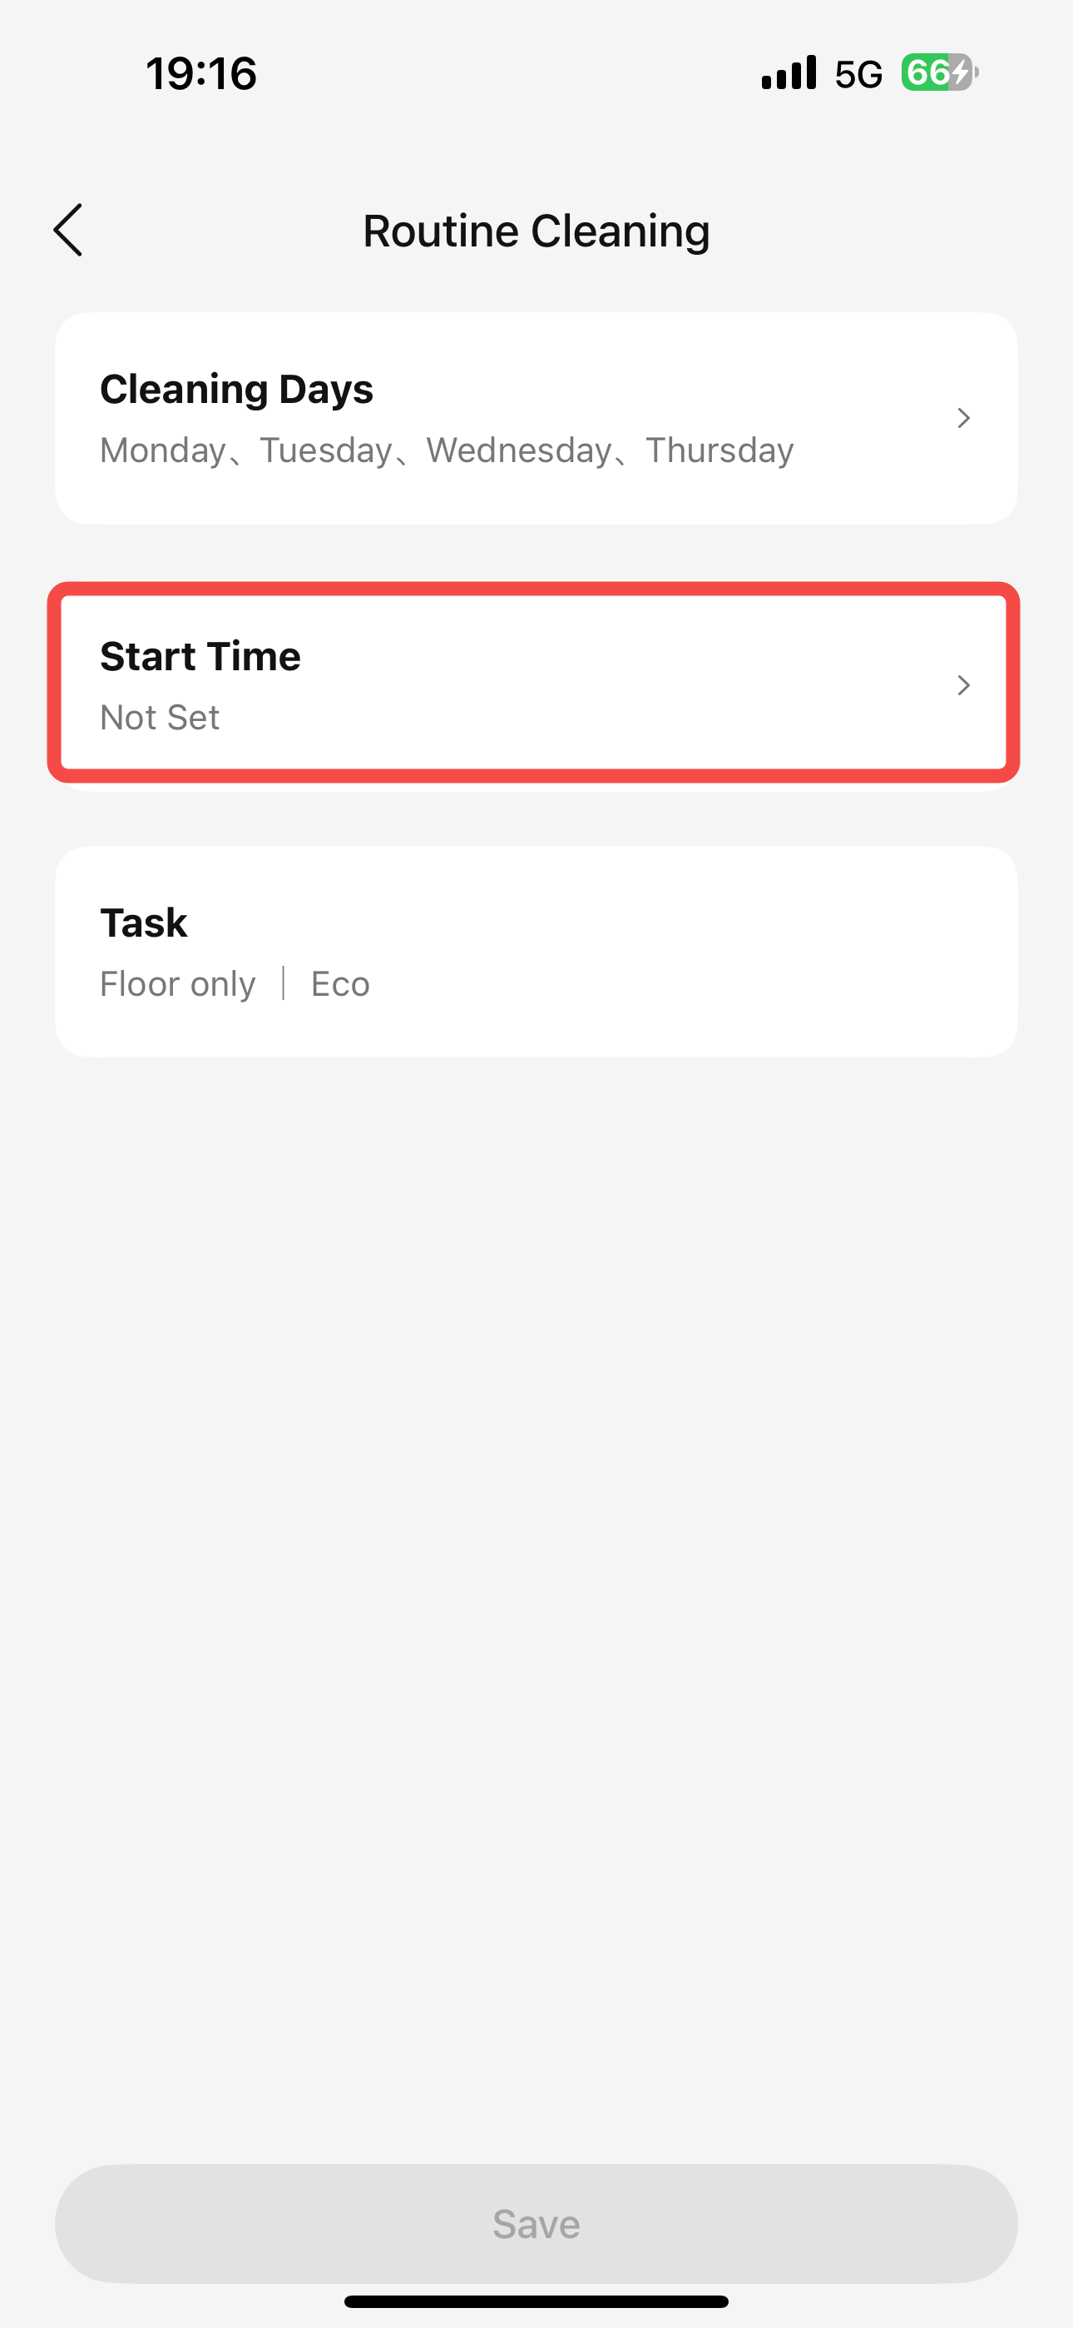
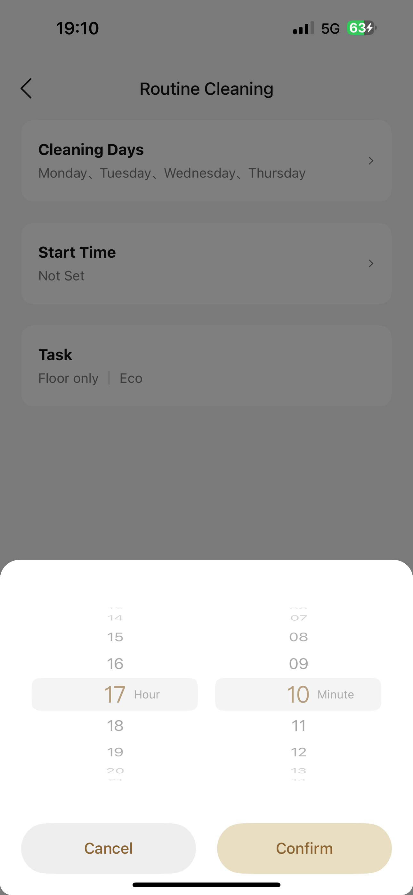
1、启动清洁 Activate the cleaning function.
8、周期清洁Routine Cleaning
仅支持单层地图使用周期清洁,开始任务时机器电量需大于等于80%、仅清洁池底、使用ECO吸力
It only supports cyclic cleaning on a single-layer map. When starting the task, the machine's battery level should be 80% or higher. It only cleans the bottom of the pool and uses ECO suction.

Slide 10
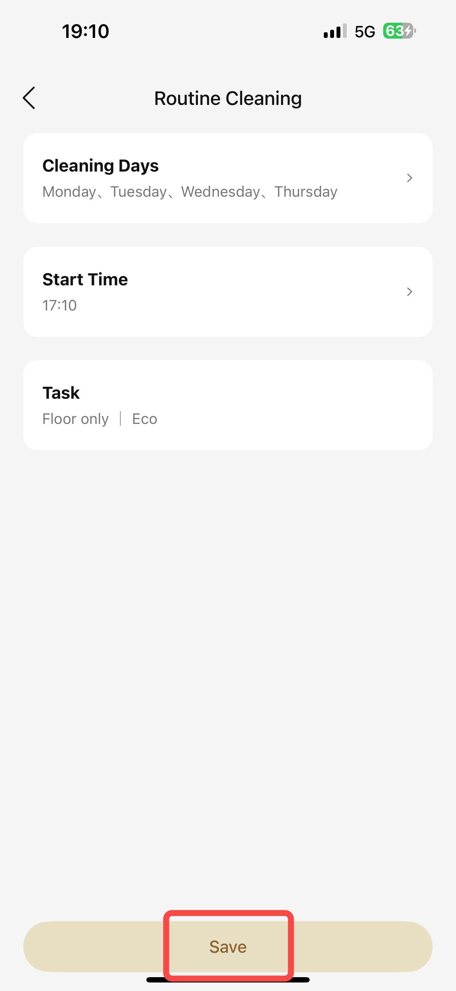
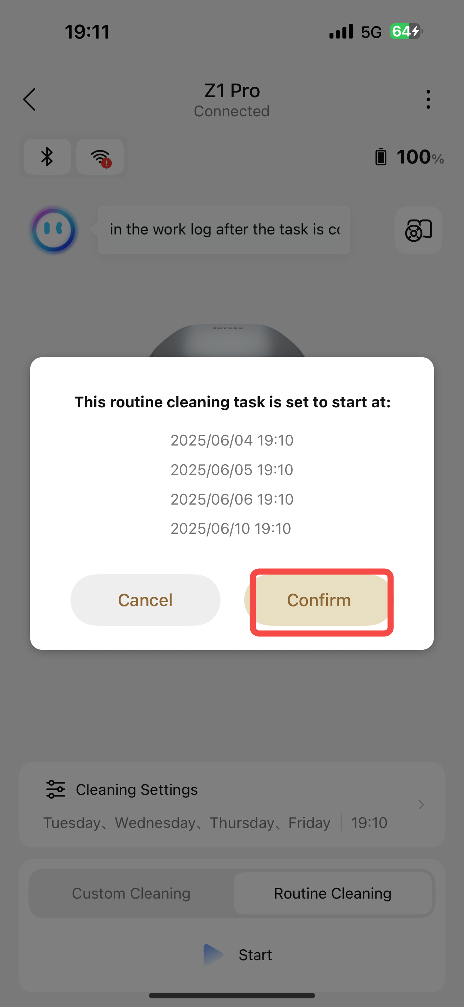
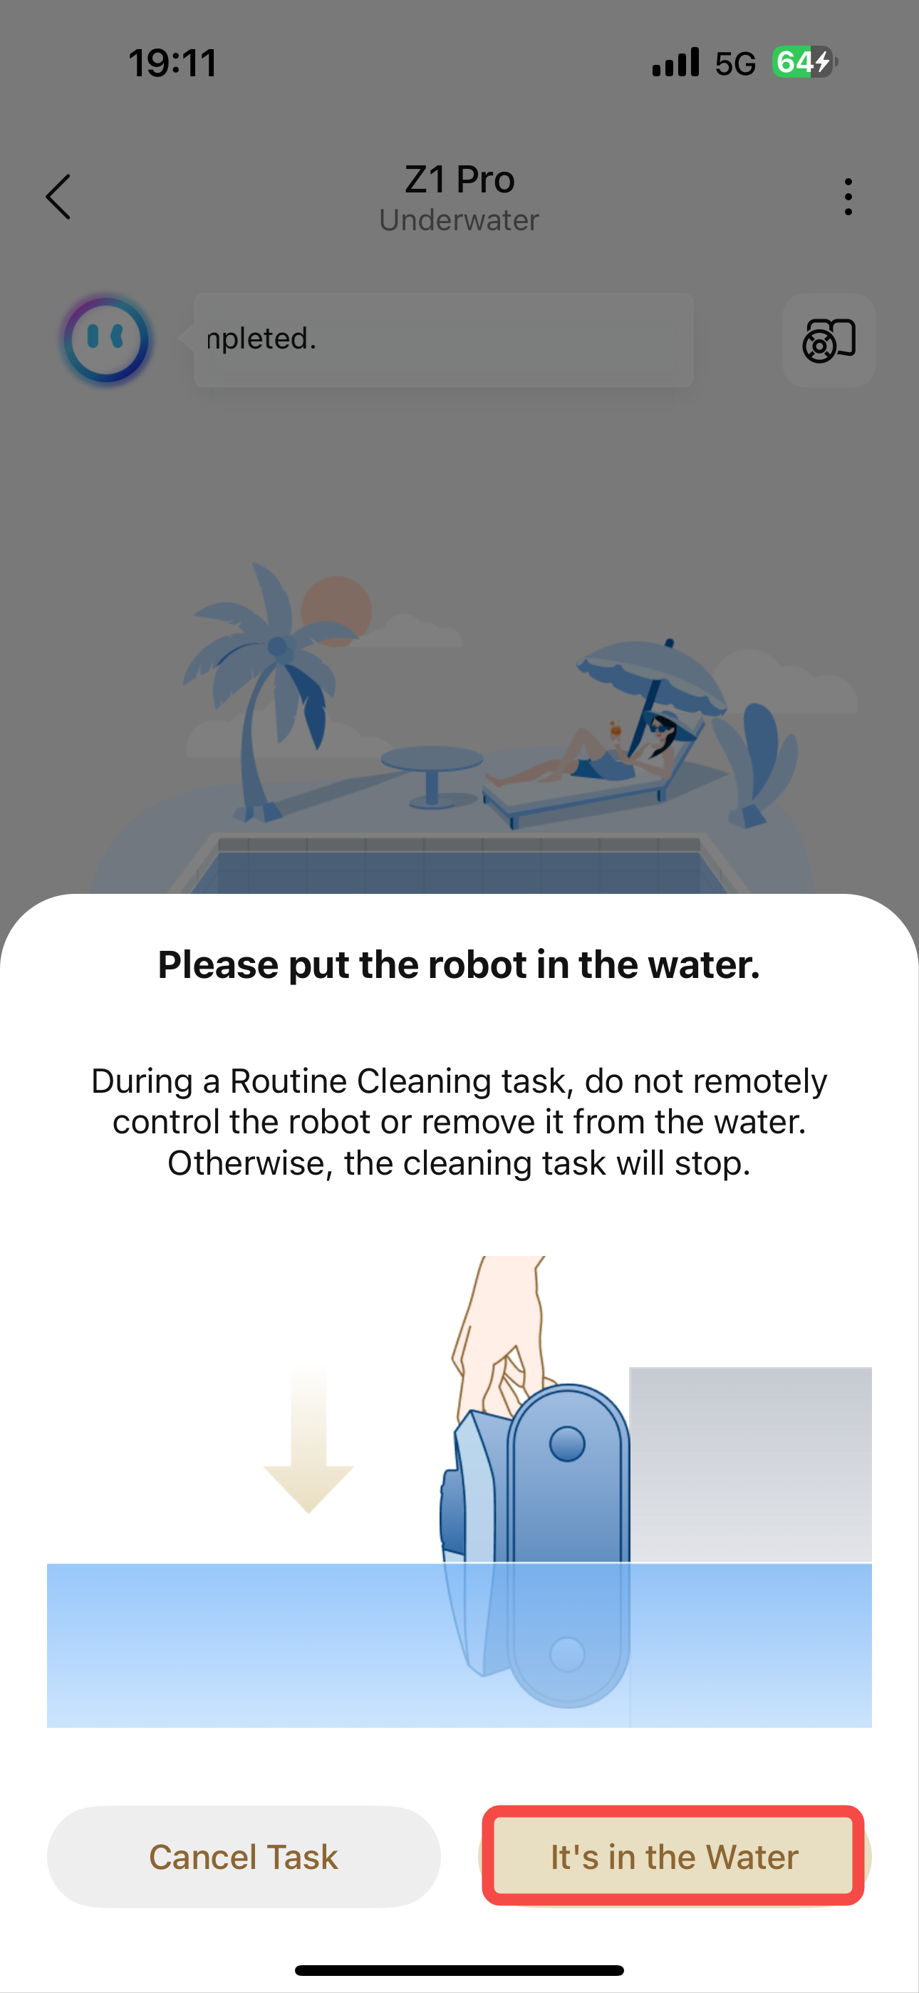
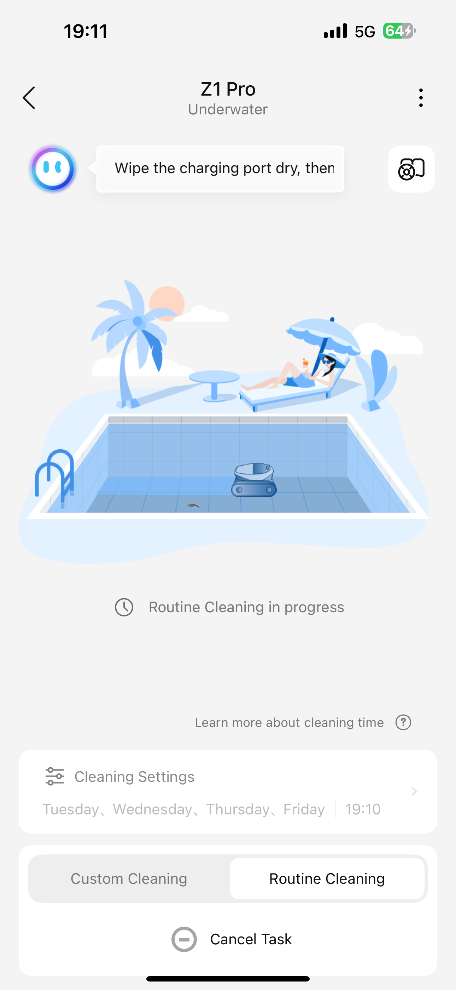
1、启动清洁 Activate the cleaning function.
8、周期清洁Routine Cleaning
仅支持单层地图使用周期清洁,开始任务时机器电量需大于等于80%、仅清洁池底、使用ECO吸力
It only supports cyclic cleaning on a single-layer map. When starting the task, the machine's battery level should be 80% or higher. It only cleans the bottom of the pool and uses ECO suction.

Slide 11
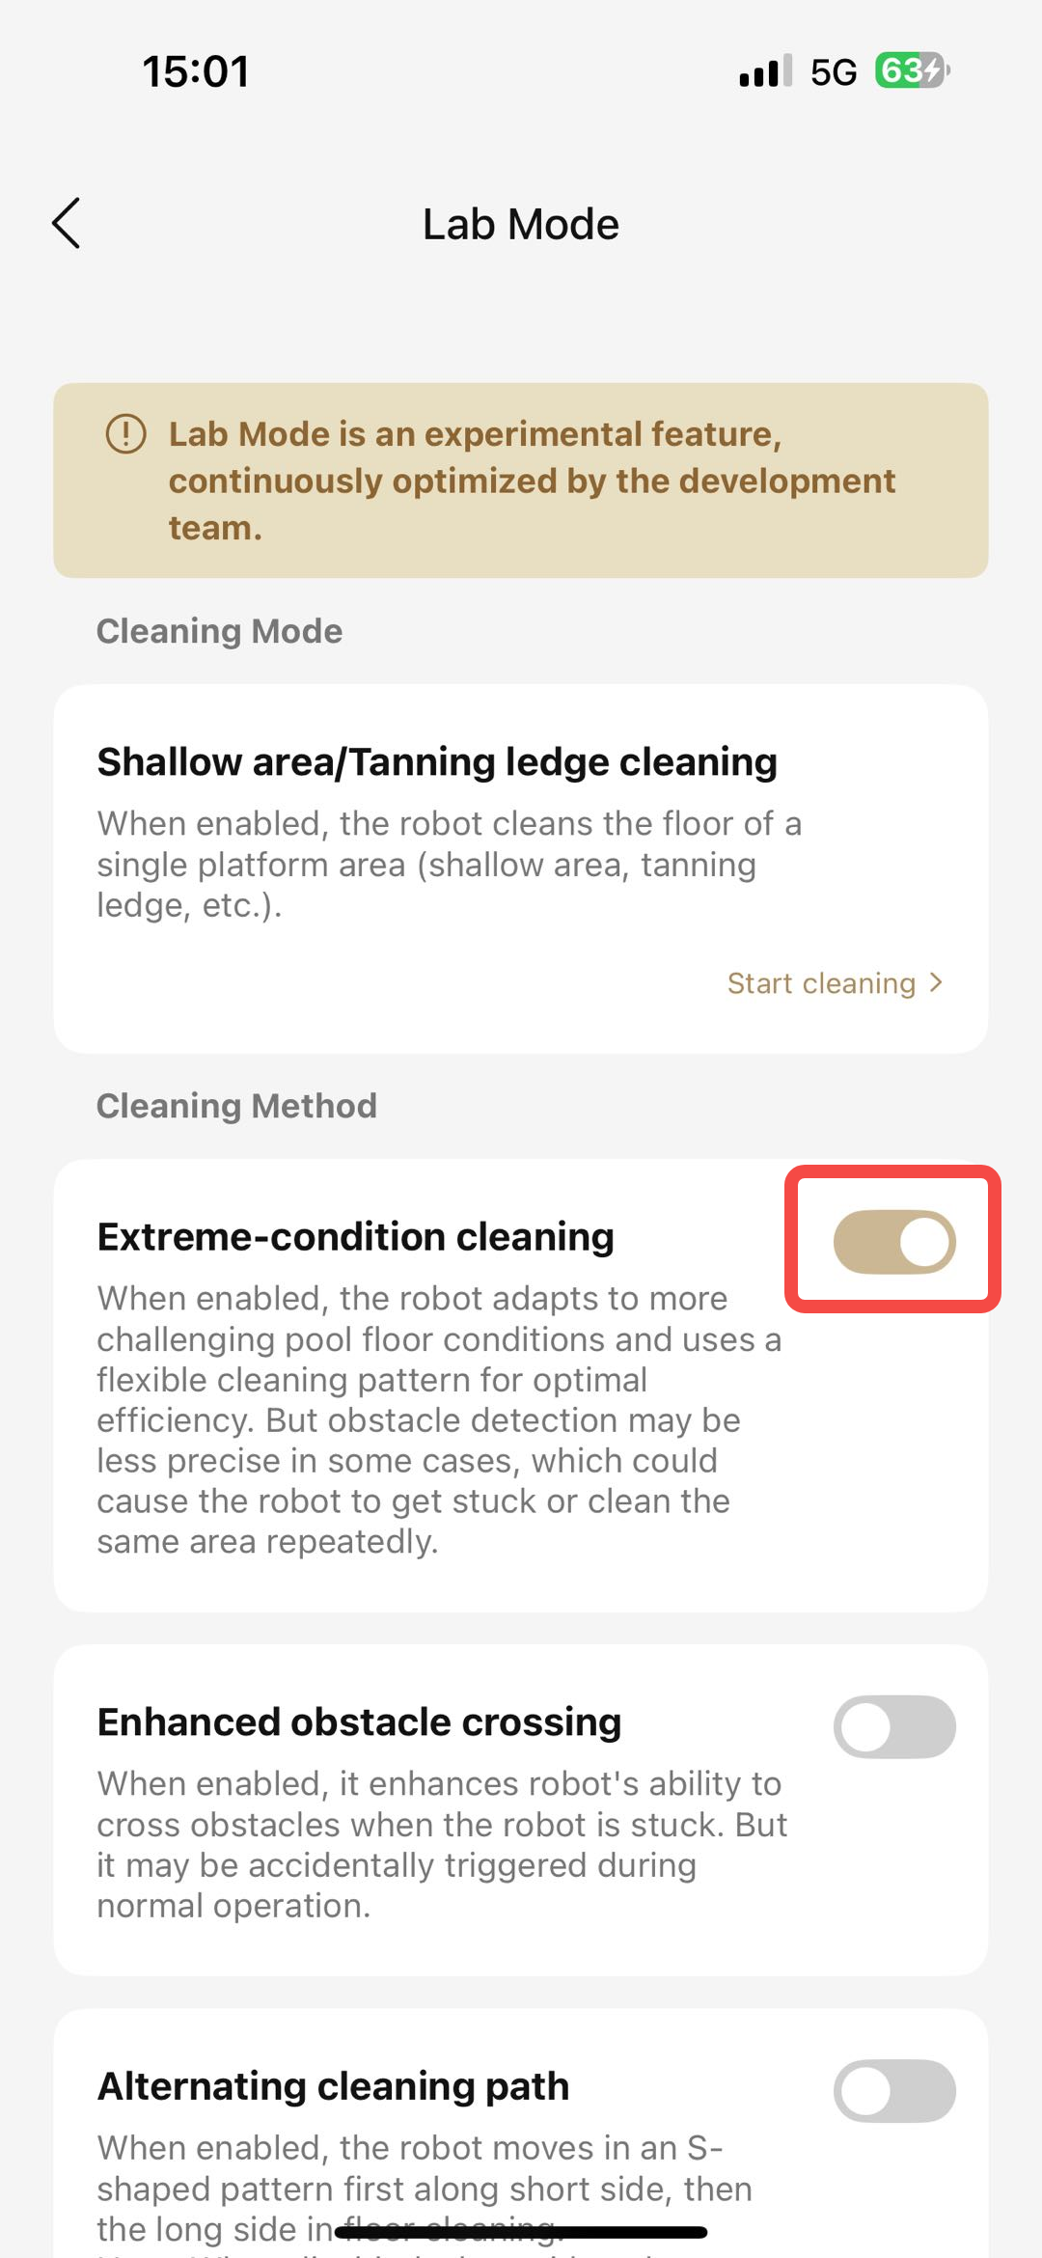
2、清洁方式相关Cleaning Method
1、极端工况清洁（开荒模式）——实验室功能
开启后，在池底清洁过程中可适应更恶劣的工况，同时会默认采用随机清洁模式以便更高效的完成清洁工作（此模式下不建图，设备进行随机行走清洁）
Extreme-condition cleaning——Lab Mode
When enabled, the robot adapts to more challenging pool floor conditions and uses a flexible cleaning pattern for optimal efficiency.

Slide 12
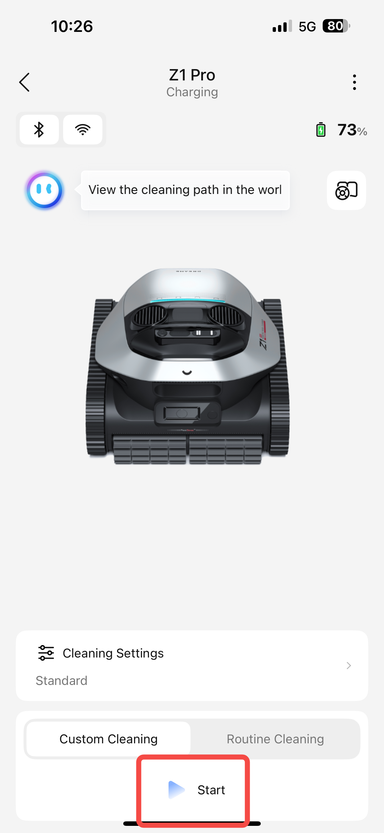
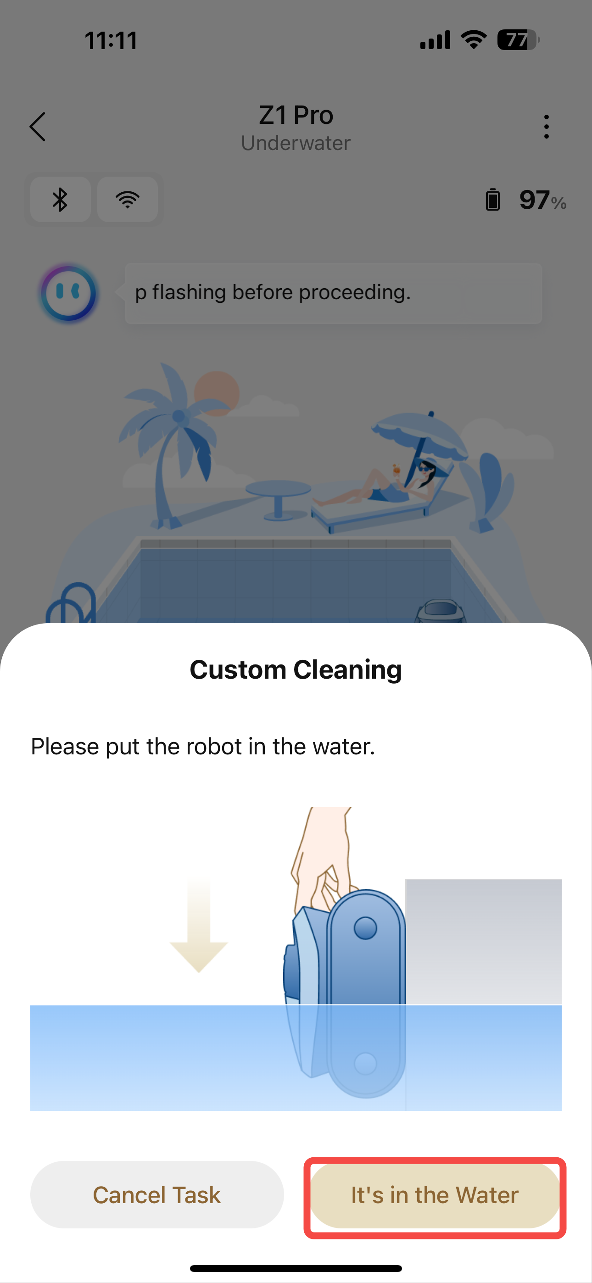
2、清洁方式相关Cleaning Method
1、极端工况清洁（开荒模式）——实验室功能
开启后，在池底清洁过程中可适应更恶劣的工况，同时会默认采用随机清洁模式以便更高效的完成清洁工作（此模式下不建图，设备进行随机行走清洁）
Extreme-condition cleaning——Lab Mode
When enabled, the robot adapts to more challenging pool floor conditions and uses a flexible cleaning pattern for optimal efficiency.

Slide 13
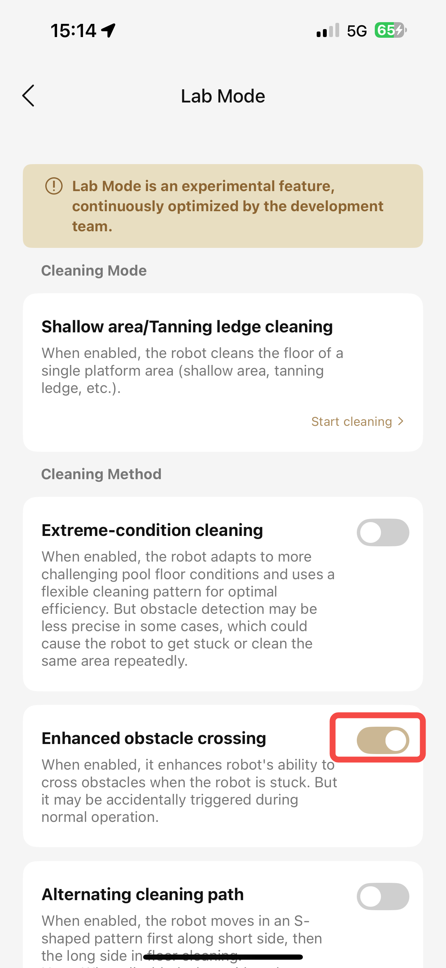
2、清洁方式相关Cleaning Method
2、脱困强化——实验室功能
开启后，会加强机器越过障碍物的能力，同时会有概率在正常行走过程中误触发
Enhanced obstacle crossing——Lab Mode
When enabled, it enhances robot's ability to cross obstacles when the robot is stuck. But it may be accidentally triggered during normal operation.

Slide 14
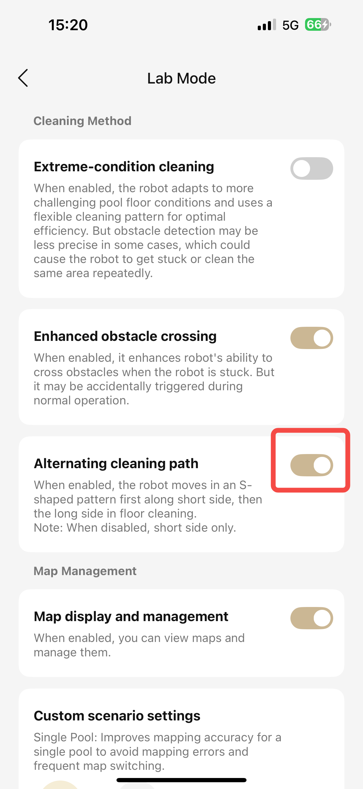
2、清洁方式相关Cleaning Method
3、清洁轨迹切换——实验室功能
开启后，池底清洁过程中，机器将先沿短边弓字行走再沿长边弓字行走。注：不开启时，机器默认沿短边弓字行走
Alternating cleaning path——Lab Mode
When enabled, the robot moves in an S-shaped pattern first along short side, then the long side in floor cleaning.
Note: When disabled, short side only.

Slide 15
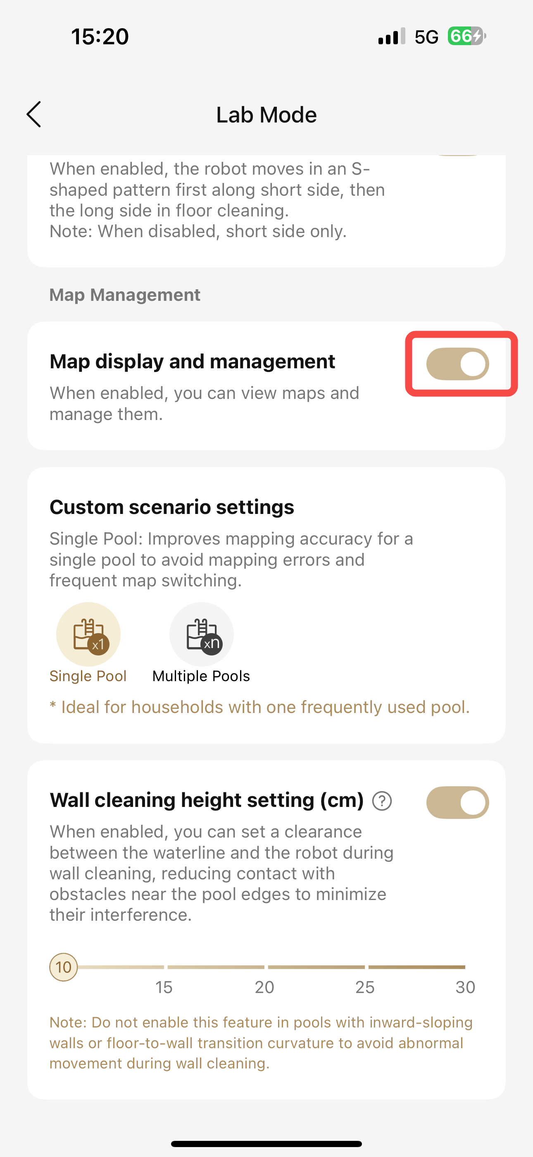
3、地图管理相关Map Management
1、地图显示与管理——实验室功能
开启后，支持查看地图并对其进行管理
Map display and management——Lab Mode
When enabled, you can view maps and manage them.

Slide 16
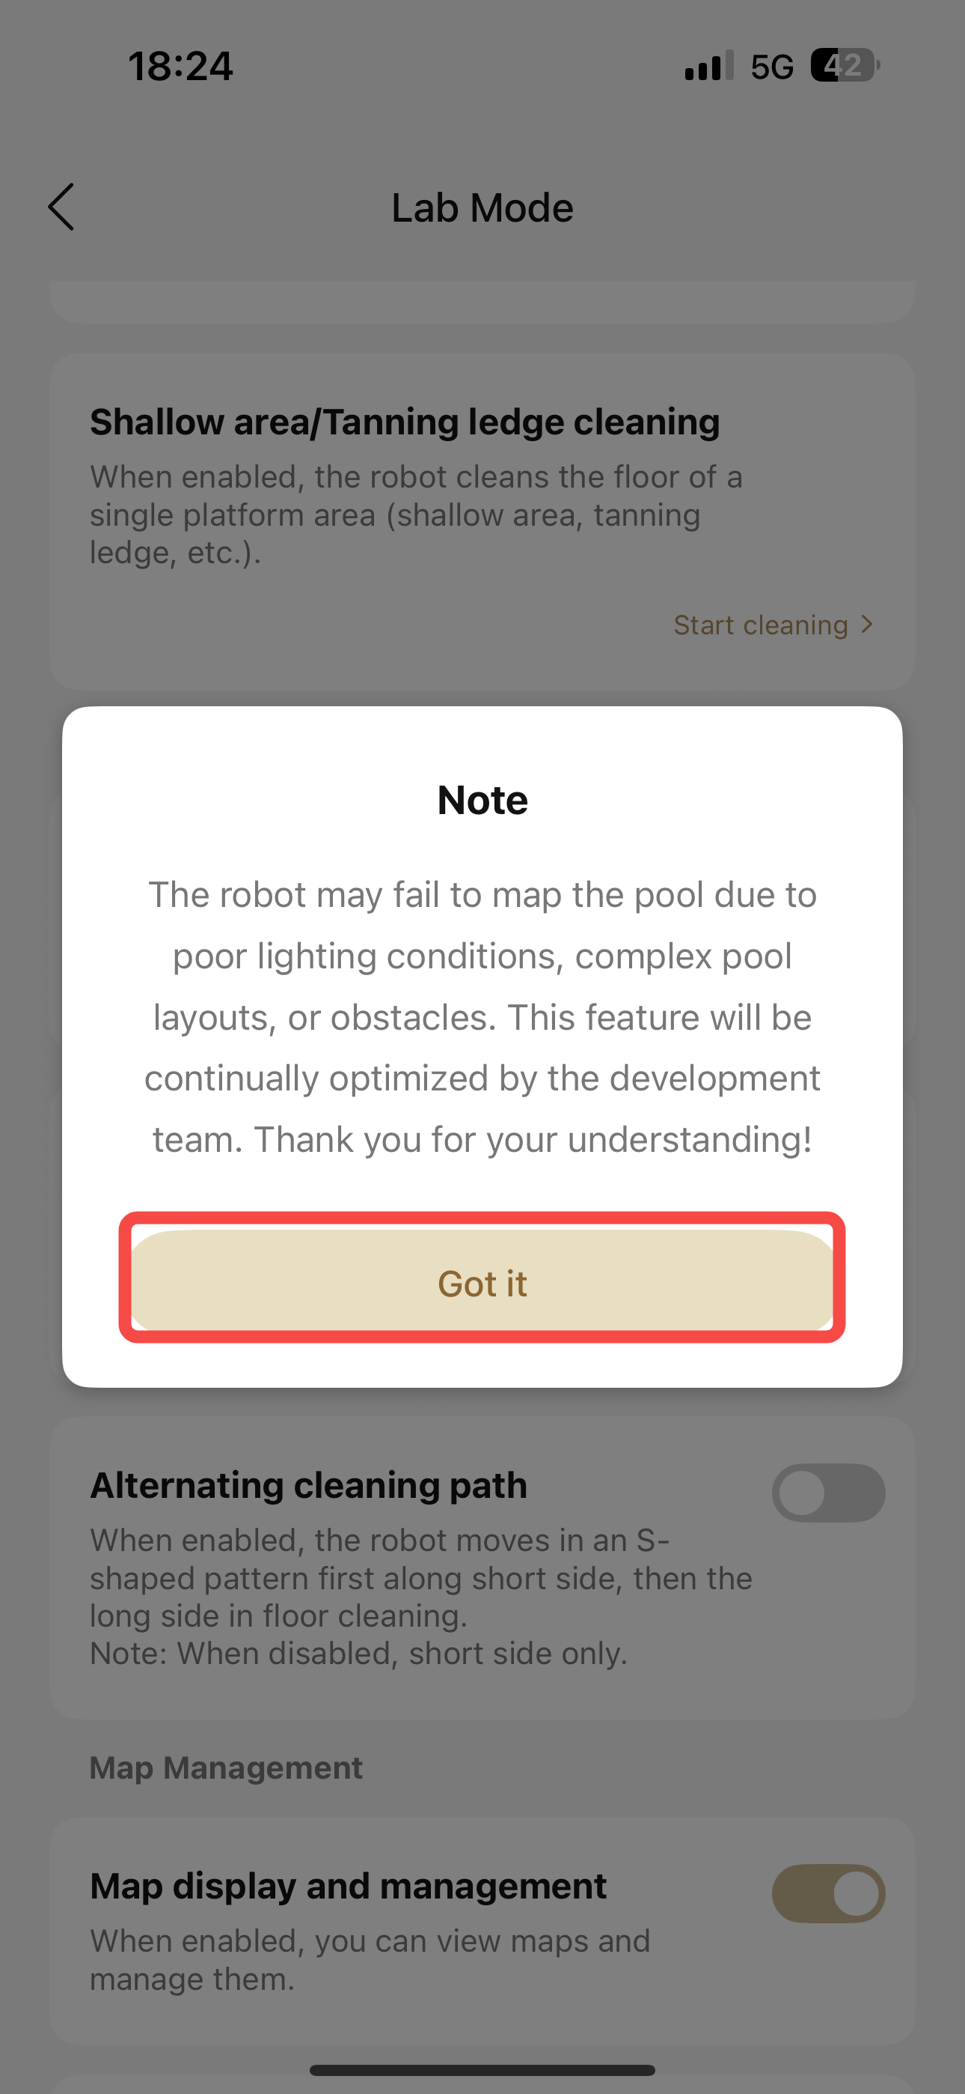
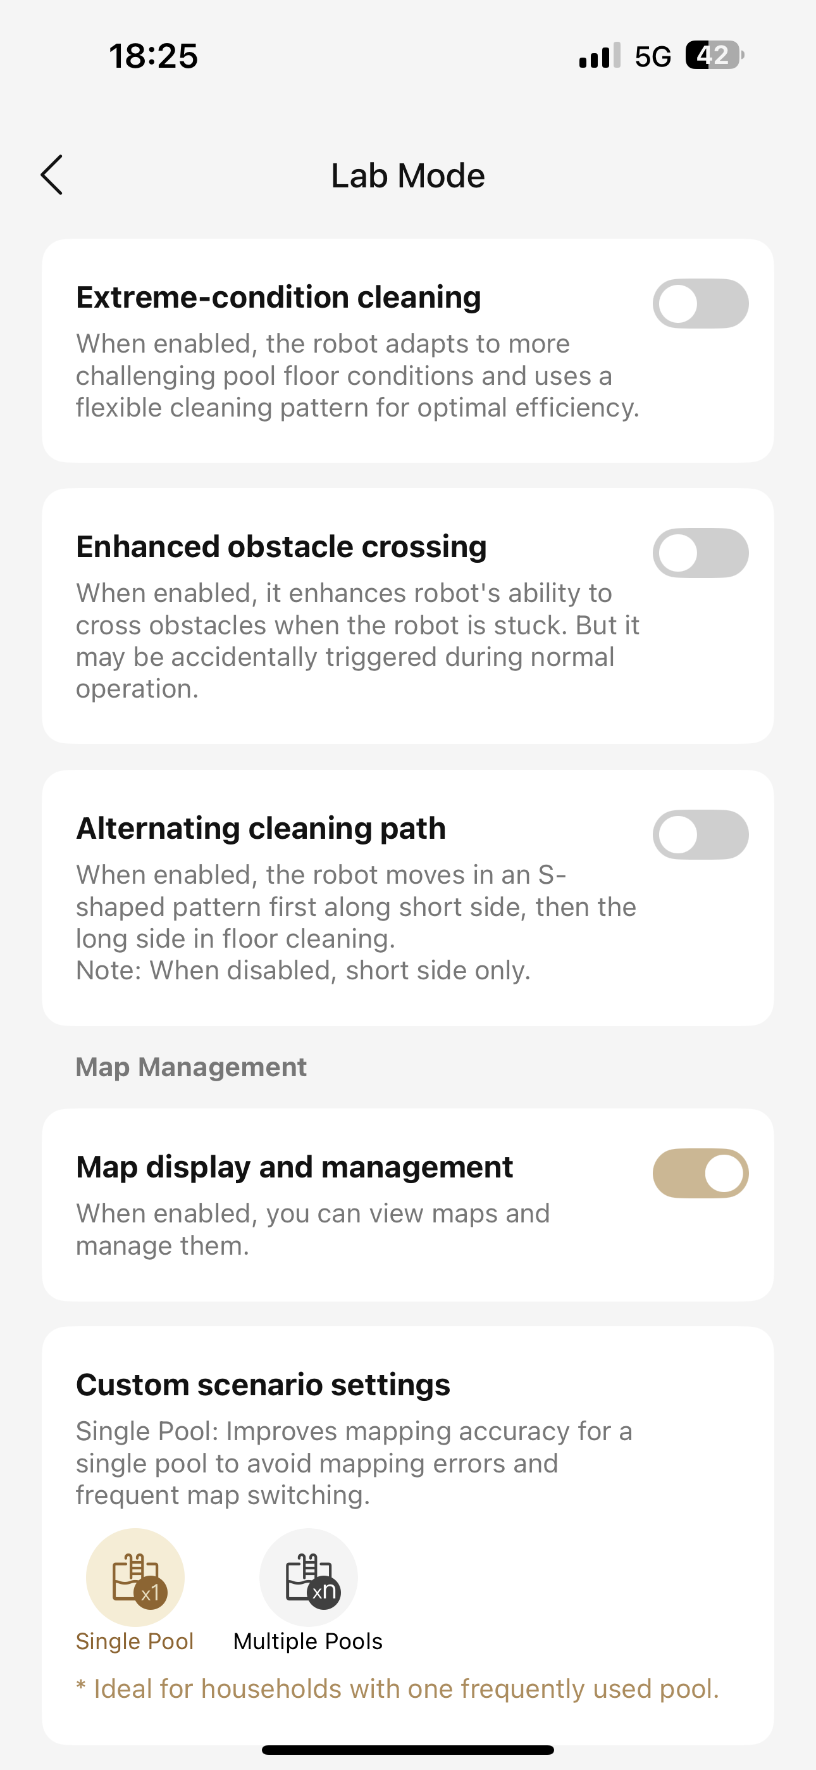
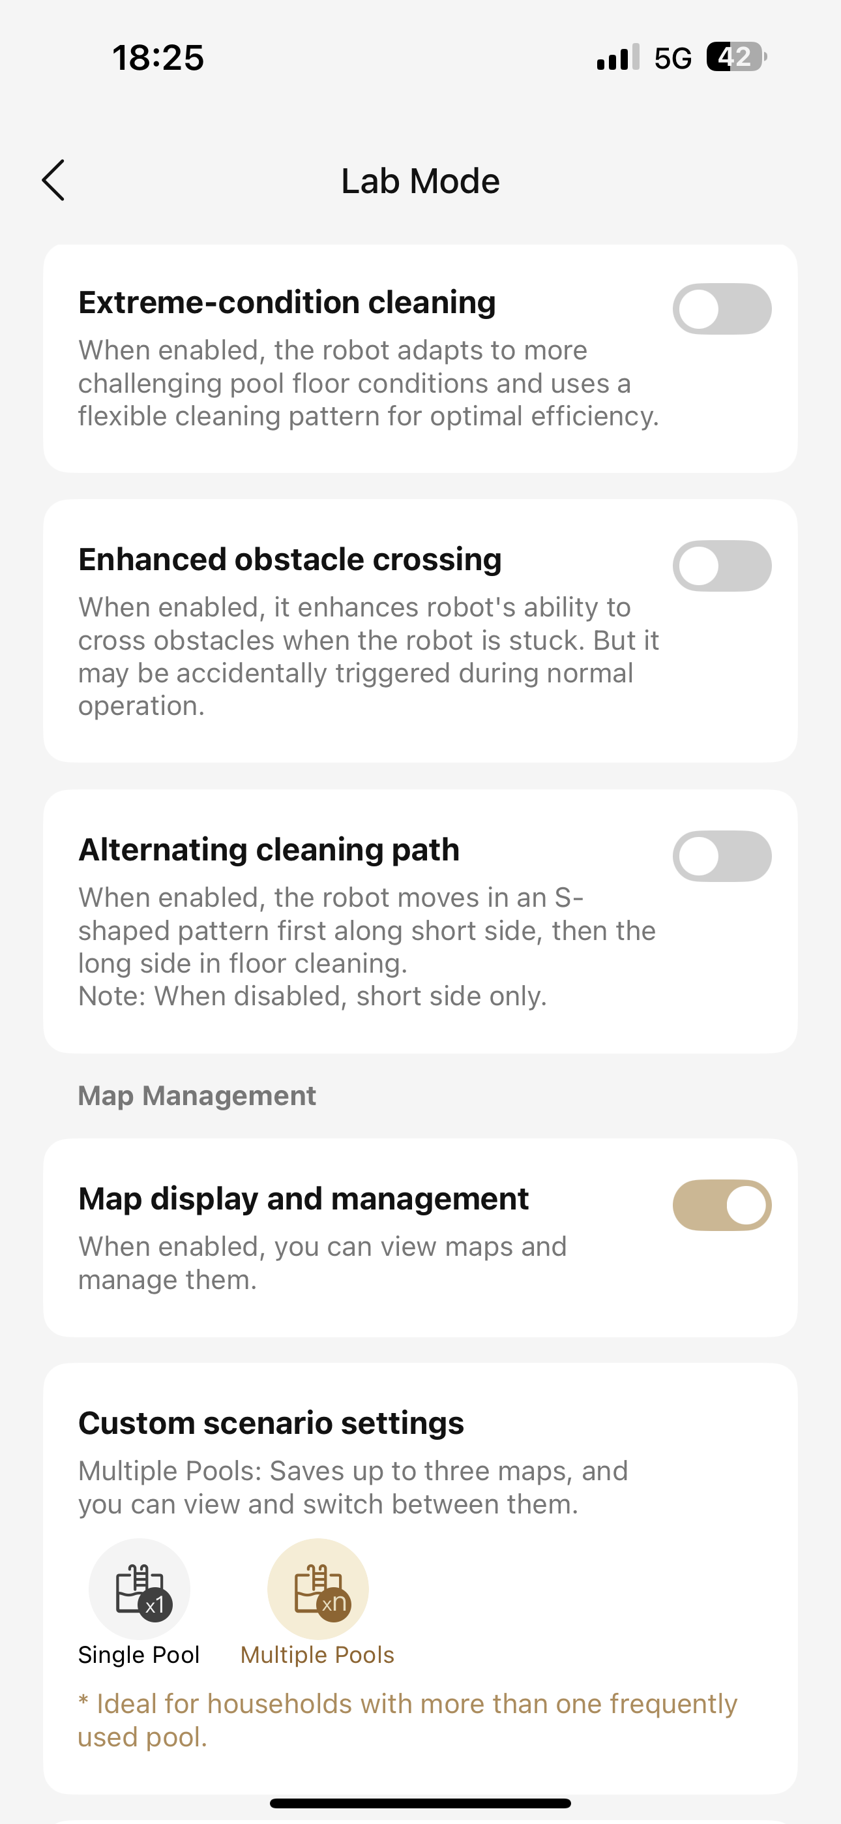
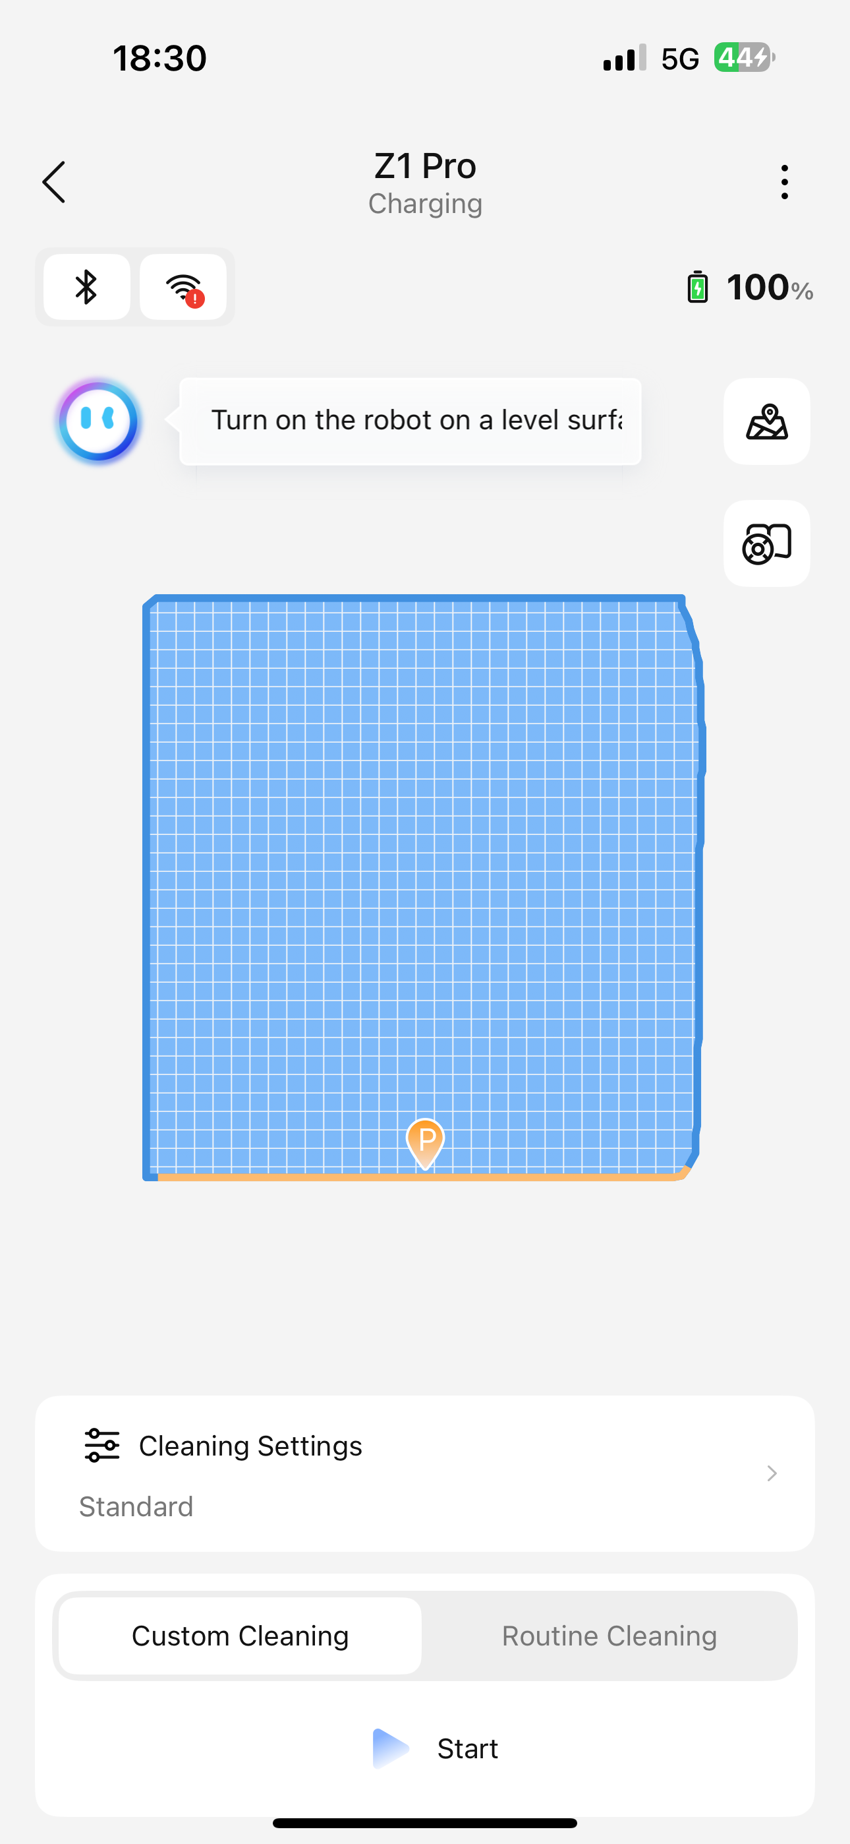
3、地图管理相关Map Management
1、地图显示与管理——实验室功能
开启后，支持查看地图并对其进行管理
Map display and management——Lab Mode
When enabled, you can view maps and manage them.

Slide 17
3、地图管理相关Map Management
2、池壁清洁高度设置（CM）——实验室功能
开启后，支持设置机器清洁池壁时，行进到与水线之间的距离，减少墙壁障碍物对池壁清洁的影响
Pool Wall Cleaning Height Setting (CM) – Laboratory Function
After activation, it allows you to set the distance between the machine's position when cleaning the pool wall and the waterline, reducing the impact of wall obstacles on pool wall cleaning.

Slide 18
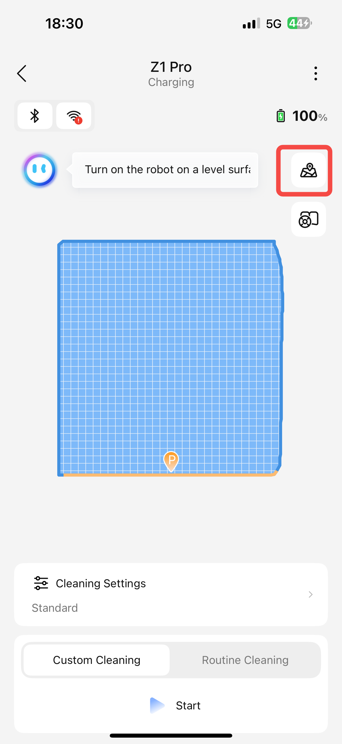
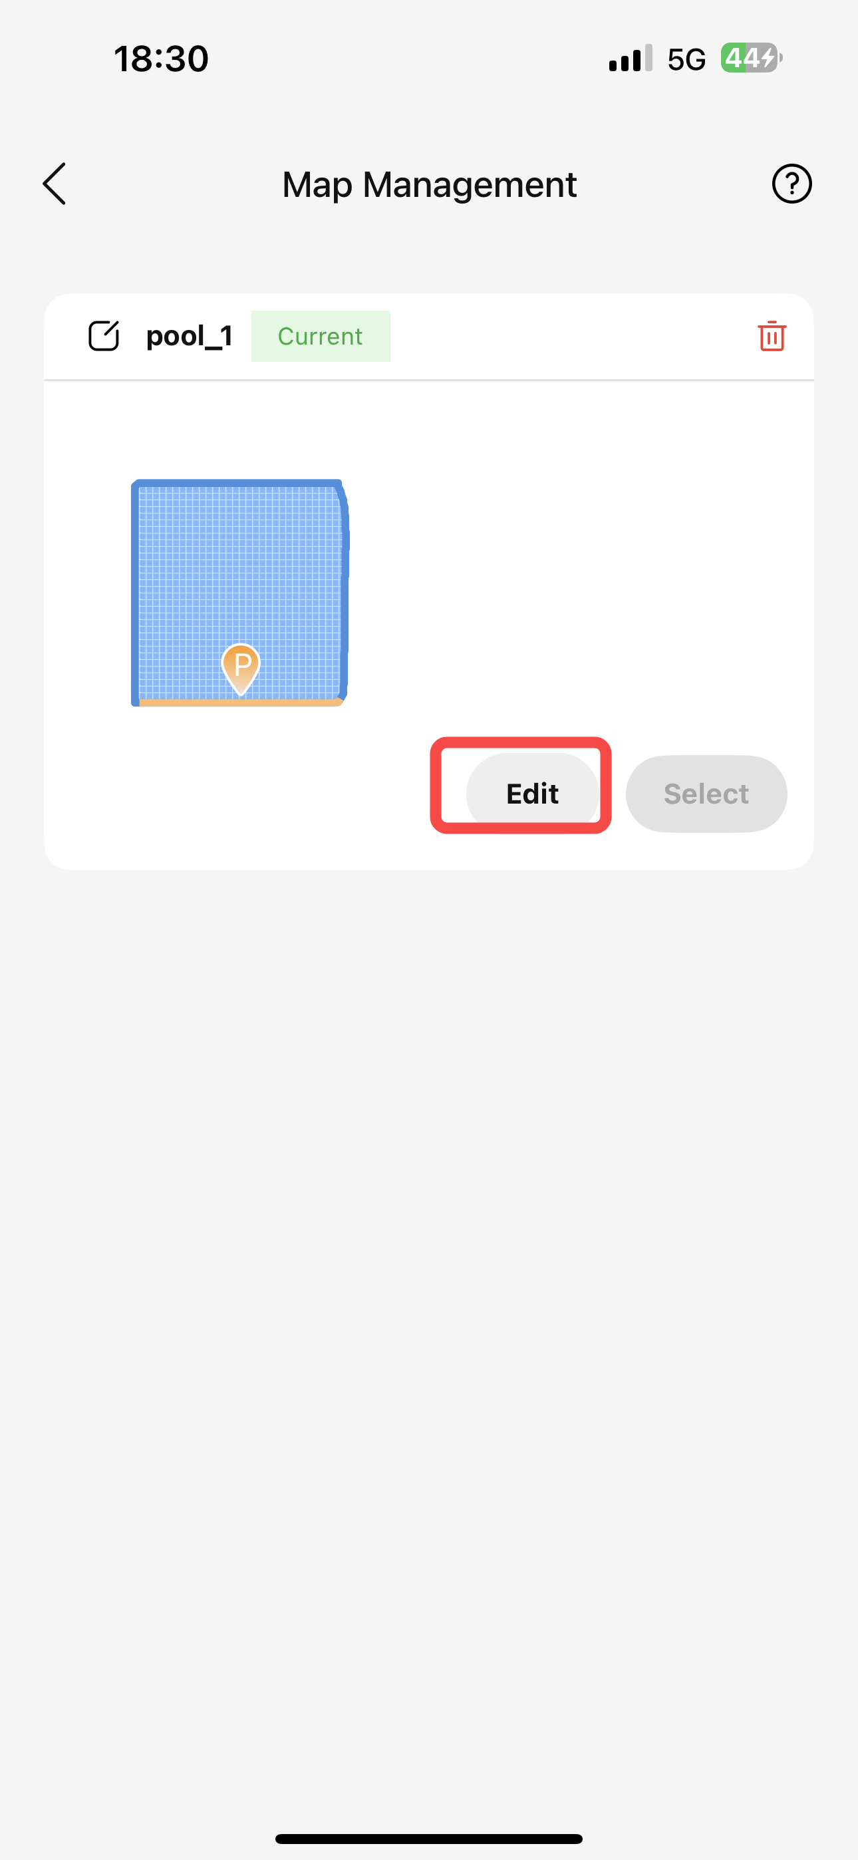
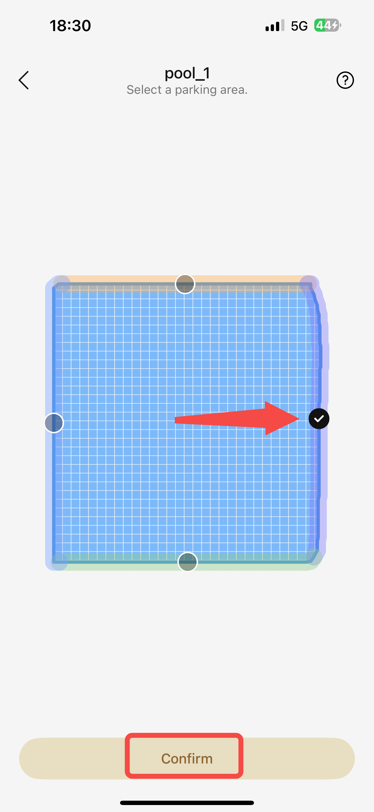
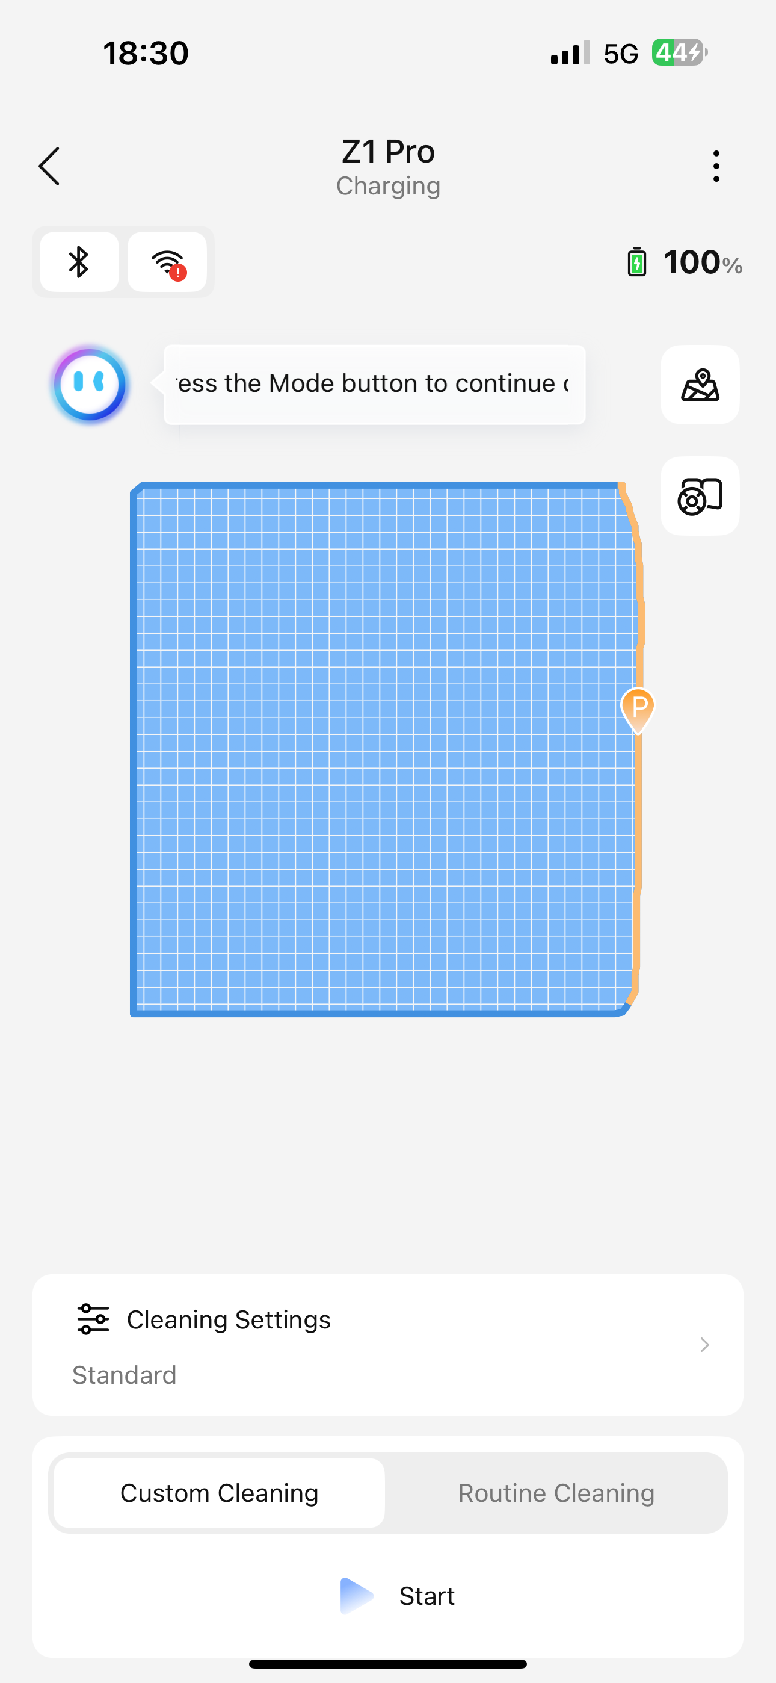
3、地图管理相关Map Management
3、编辑地图Edit the map
编辑地图停靠区Edit Map Area P

Slide 19
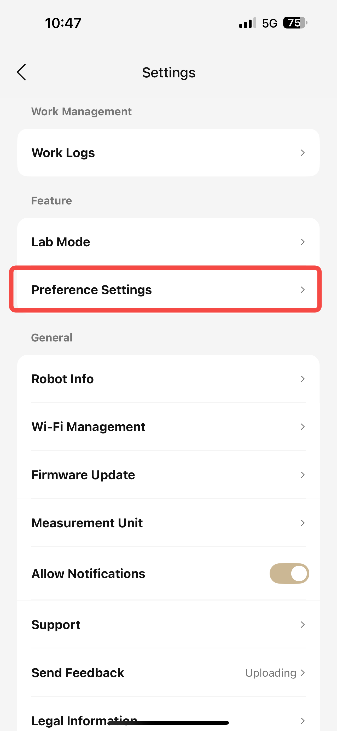
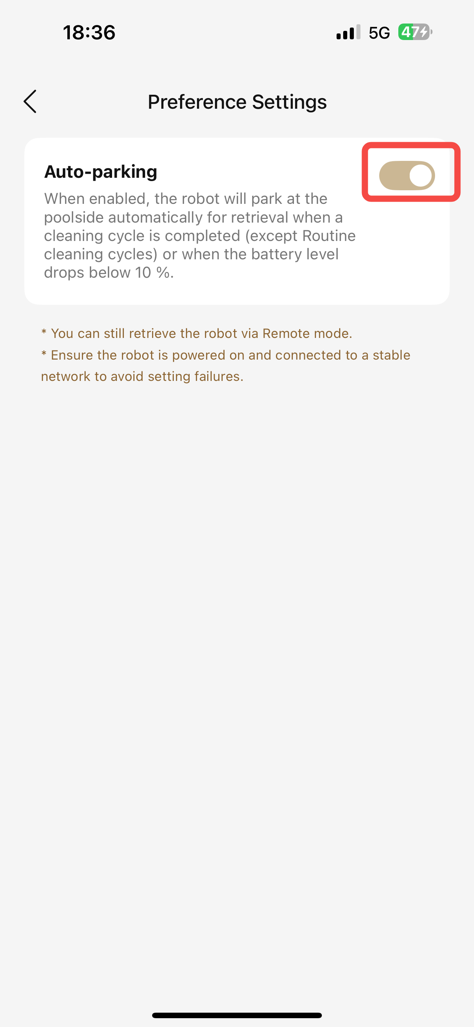
4、偏好设置Preference Settings
1、机器自动挂岸
开启后，机器人将会在清洁任务完成（除周期清洁外）、设备电量低于10%时自动挂岸
遥控召回功能不受此处设置影响，可正常执行
请在机器开机且有通讯（不在水下）状态下进行设置，否则可能导致设置失败
Auto-parking
When enabled, the robot will park at the poolside automatically for retrieval when a cleaning cycle is completed (except Routine cleaning cycles) or when the battery level drops below 10 %.
You can still retrieve the robot via Remote mode
Ensure the robot is powered on and connected to a stable network to avoid setting failures.

Slide 20
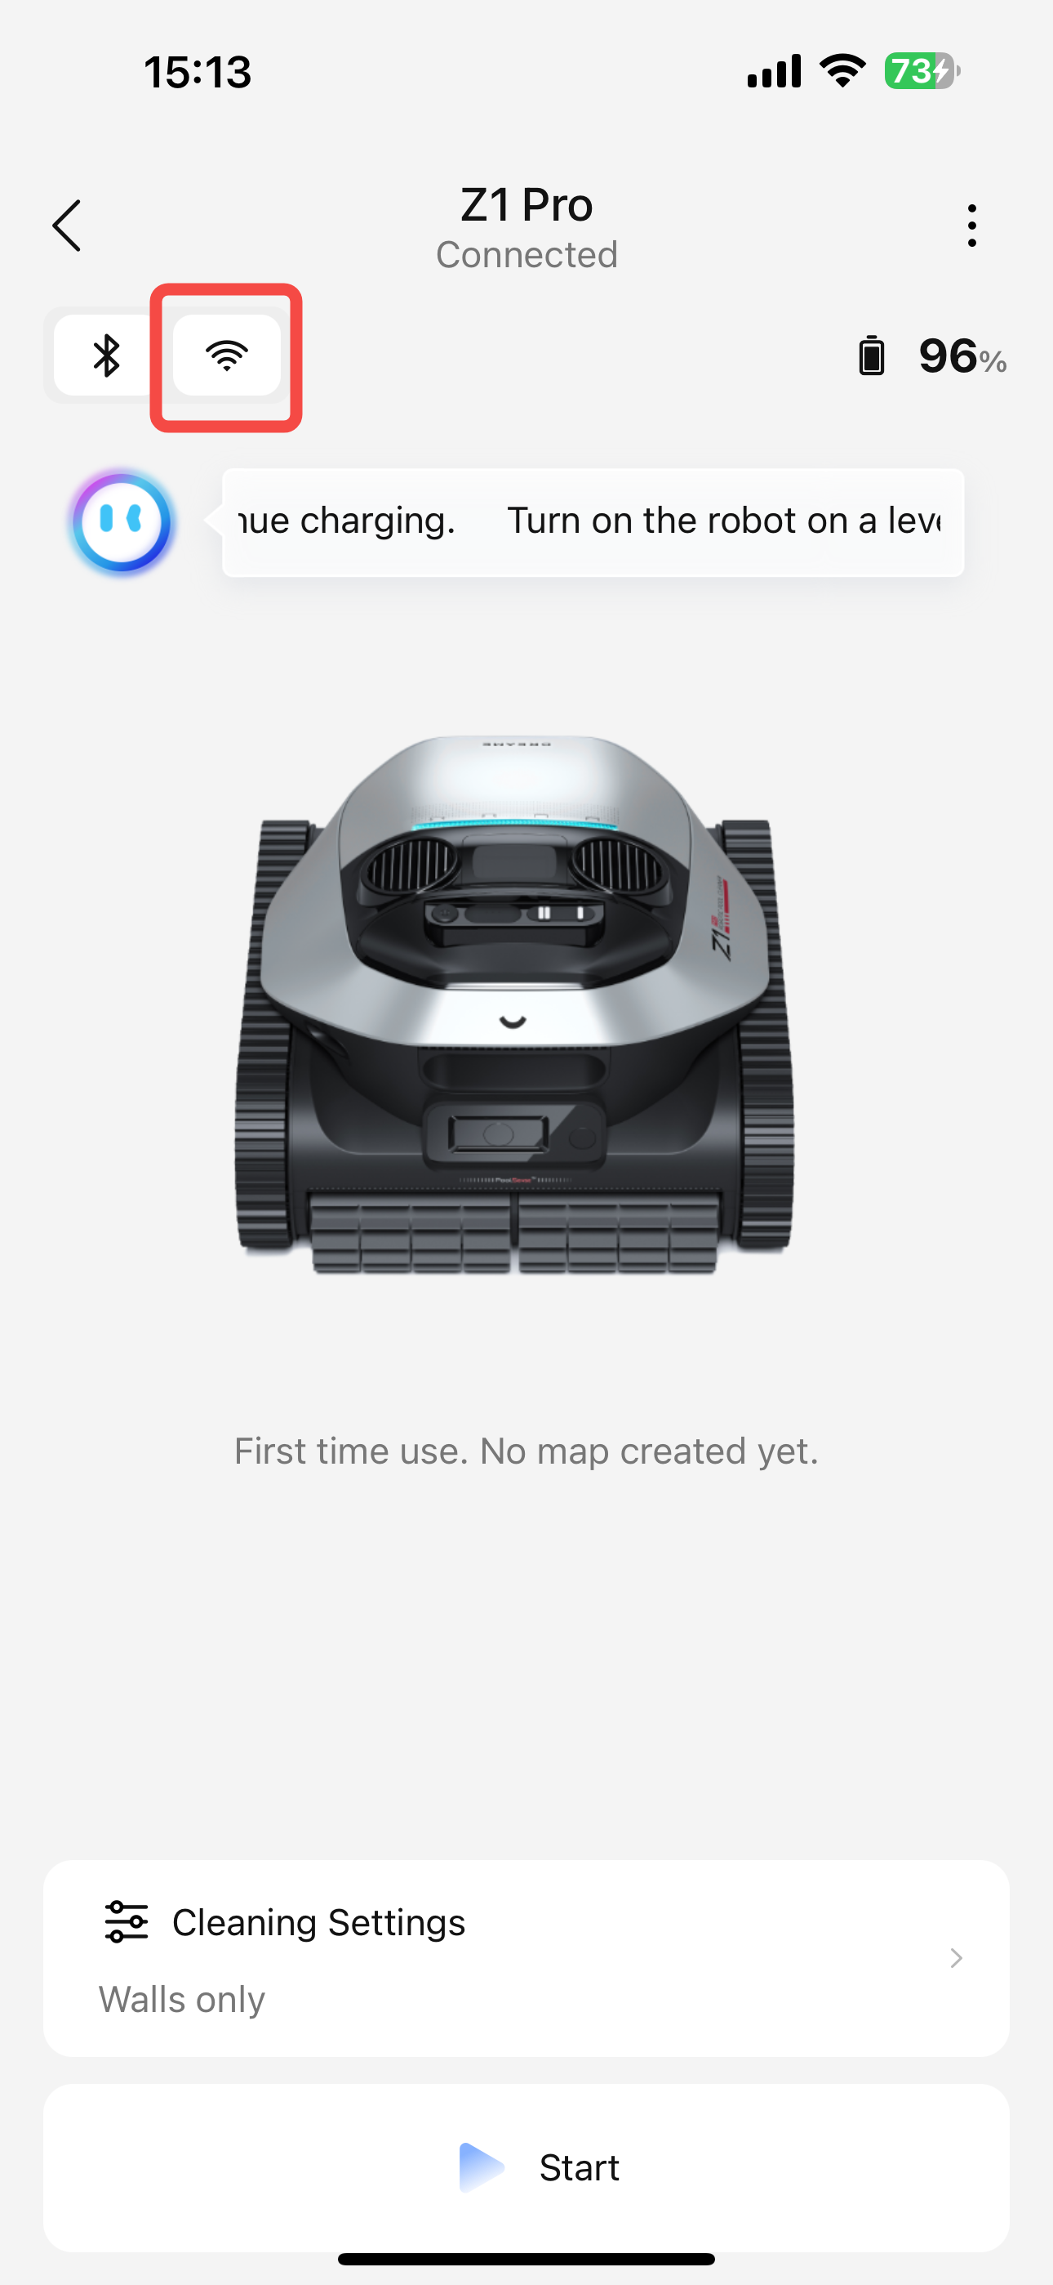
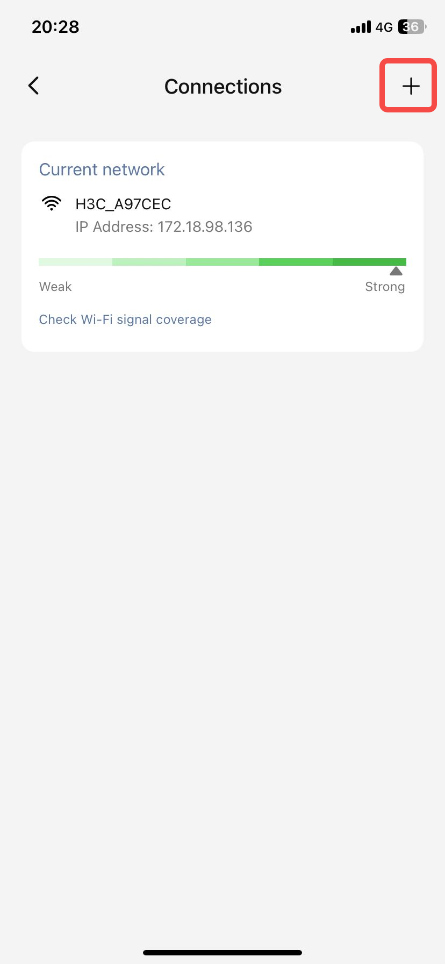
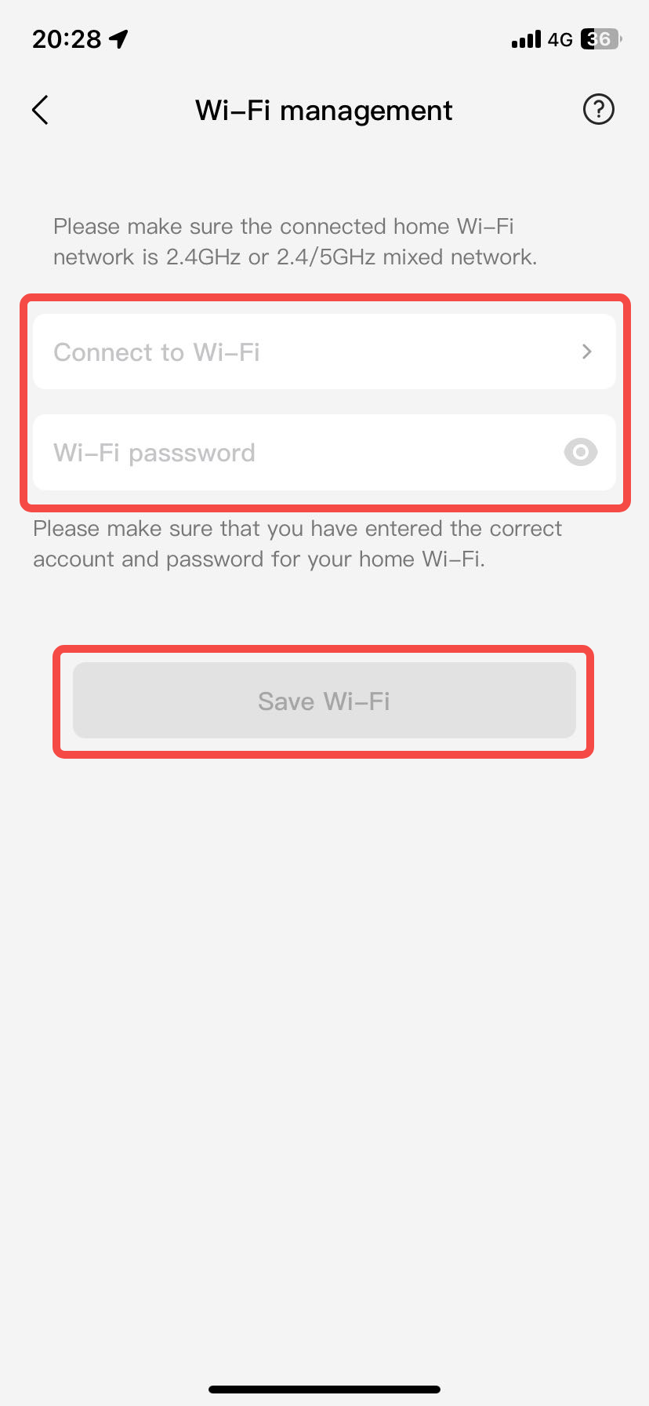
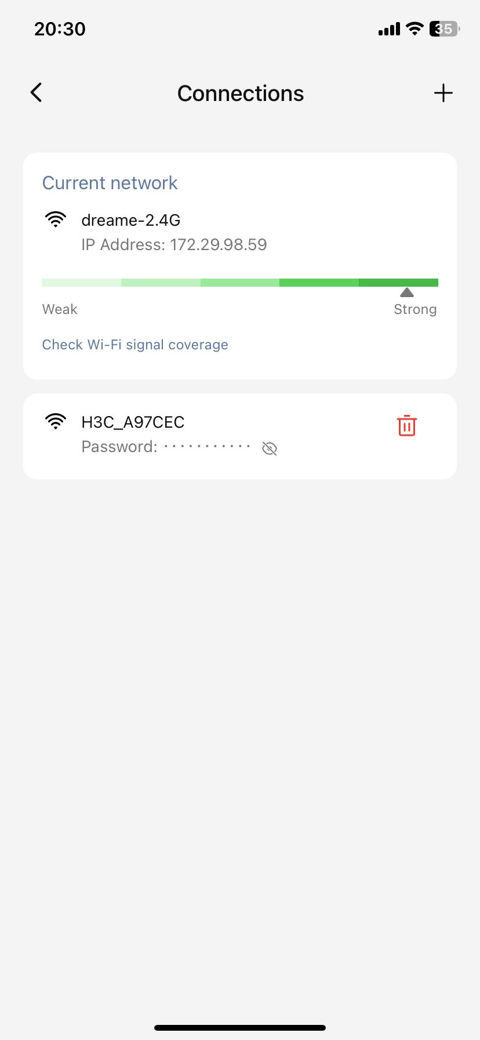
5、WIFI设置WIFI Settings
1、添加WIFI Add wifi

Slide 21
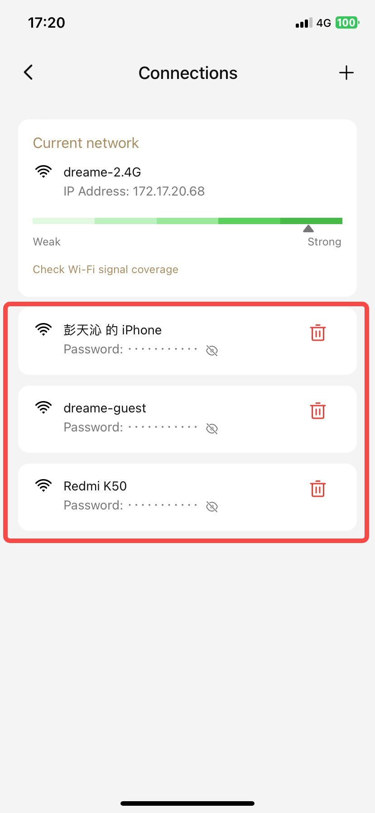
5、WIFI设置WIFI Settings
2、切换WIFI：点击要切换的WIFI进行切换 Switching WiFi: Click on the desired WiFi network to switch to it.

Slide 22
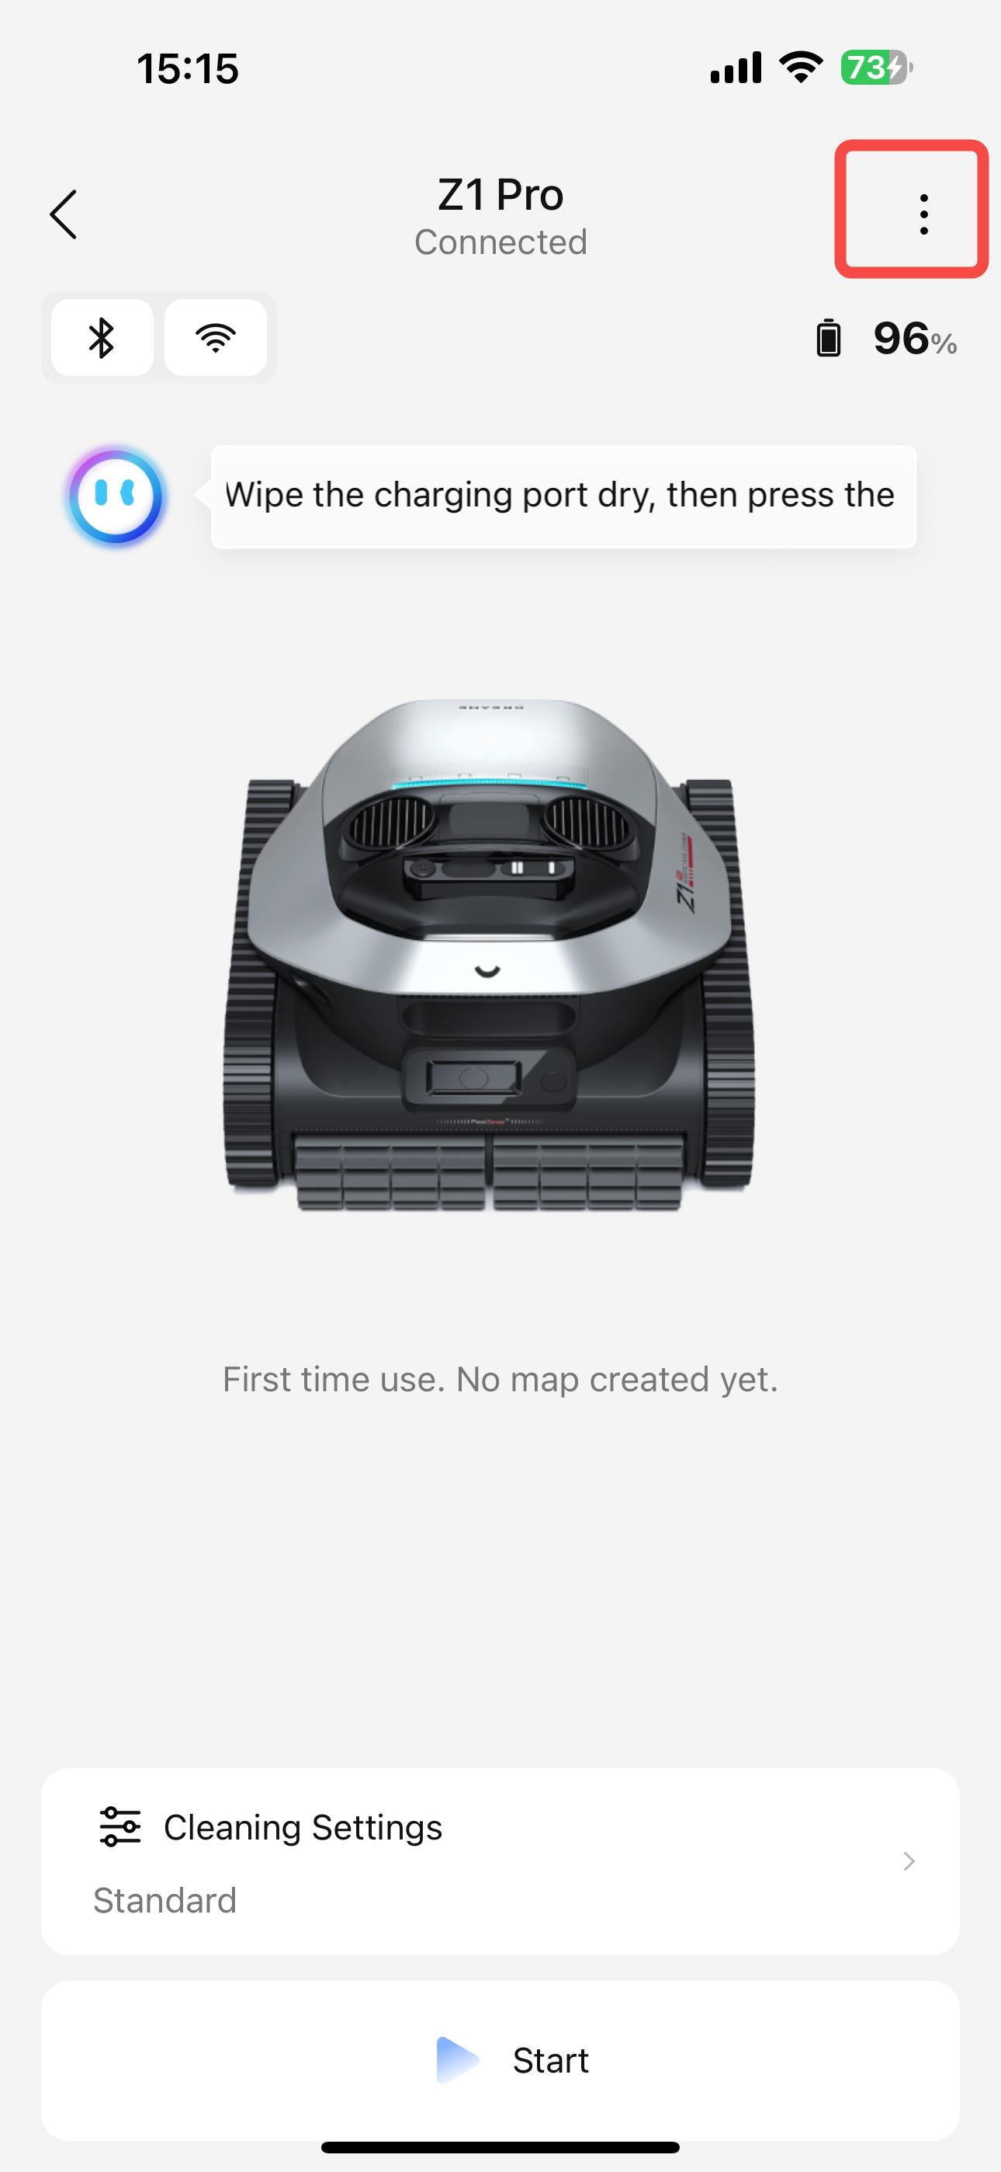
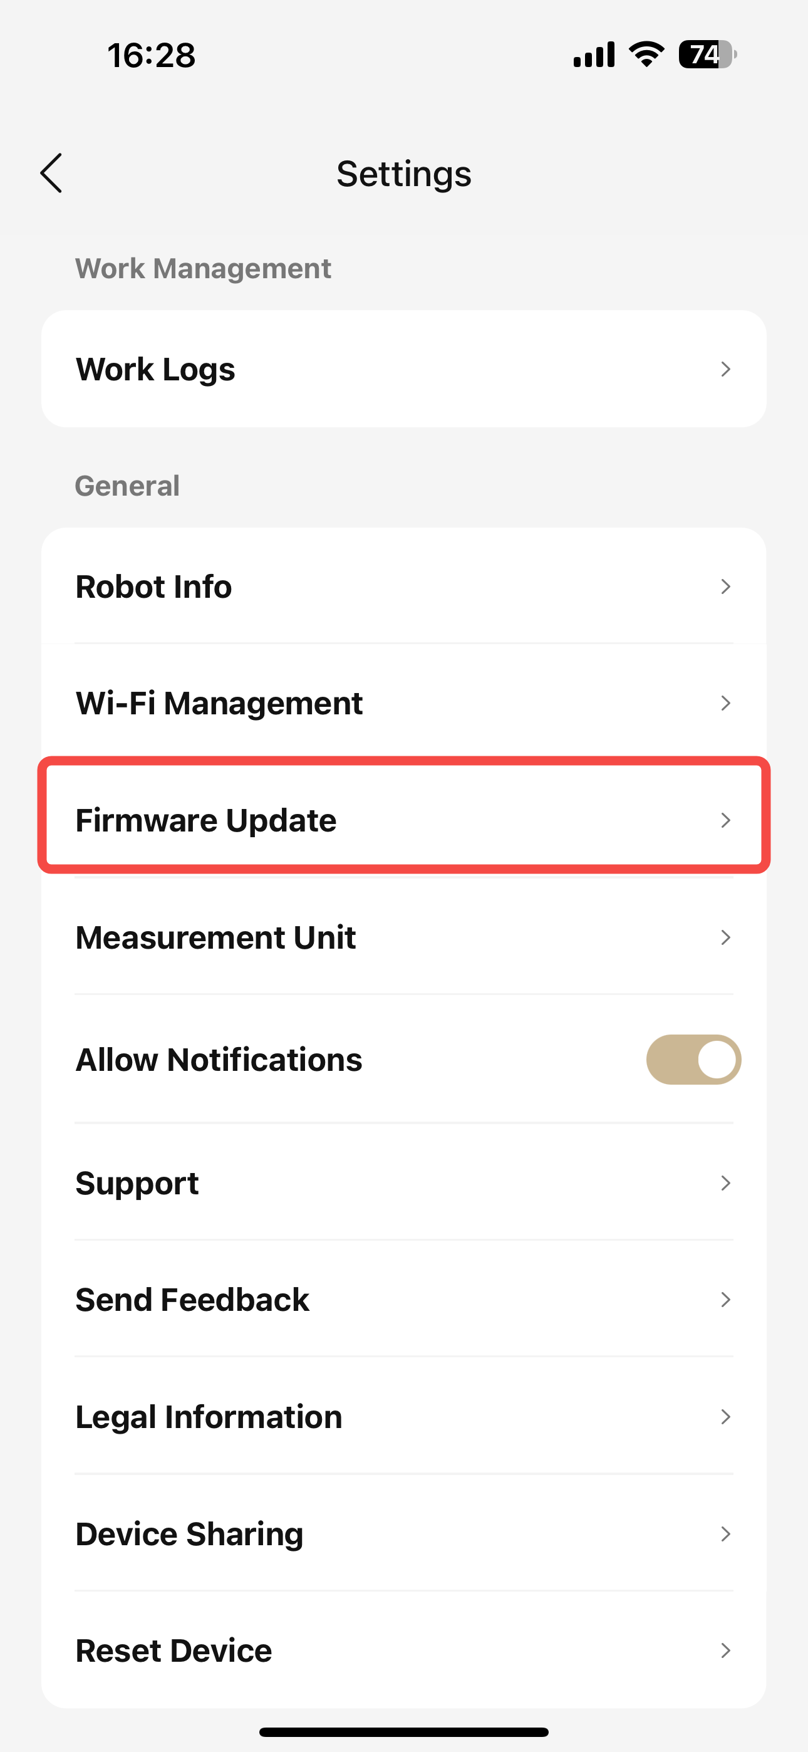

6、固件升级 OTA
升级最新固件版本 Upgrade to the latest firmware version

Slide 23


7、单位转换Unit conversion
更换显示面积单位 Changing display area units

Slide 24


8、共享设备Shared device
将设备共享给家人或朋友 Share your device with family or friends

Slide 25




日志上传 Report Logs
在APP-我-帮助与反馈-报告log中，选择设备以及APP的日志，点击上传
In the app, go to Me - Help & Feedback - Report Log, select the device and the app's log, then click Upload.
Notes:
单击此处添加文本

Slide 26



查询SN
在APP-机器人页面-菜单栏-机器人信息-SN
In APP- Robot page - Menu bar - Robot information -SN
Notes:
单击此处添加文本

Slide 27

查询UID
在APP-我
In the app, go to Me
Notes:
单击此处添加文本

Slide 28



解绑设备Unbinding equipment
在APP-菜单栏-删除设备
In the app-Menu bar-Delete
Notes:
单击此处添加文本

