Slide 1
泳池清洁机器人J1—APP常用功能操作指引
Swimming pool cleaning robot J1 - APP common function operation guide
Notes:
单击此处添加文本

Slide 2
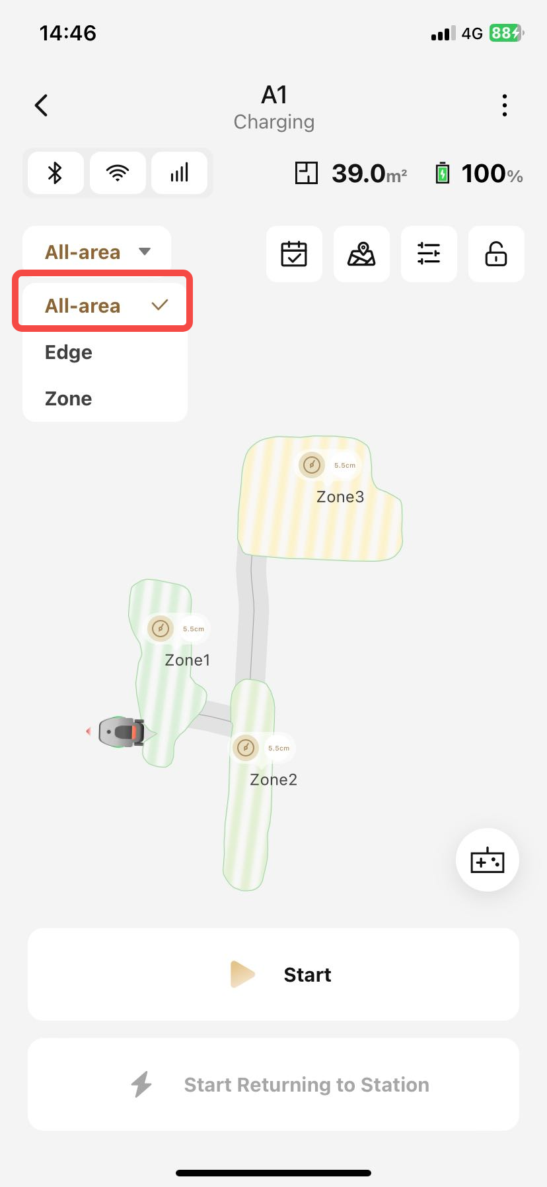
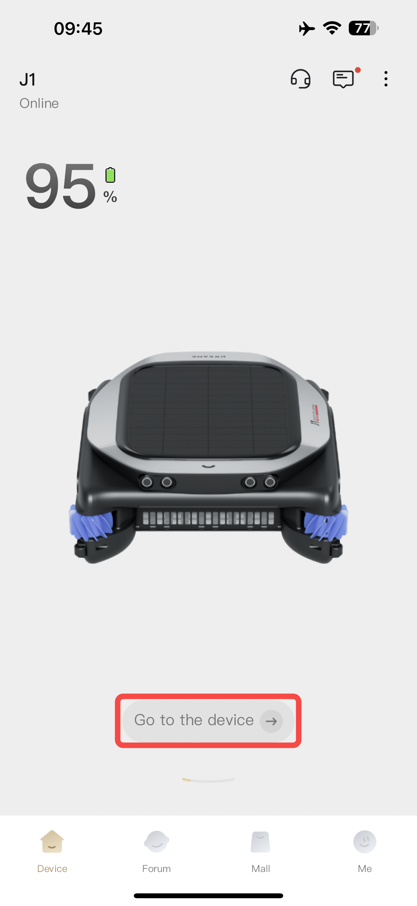
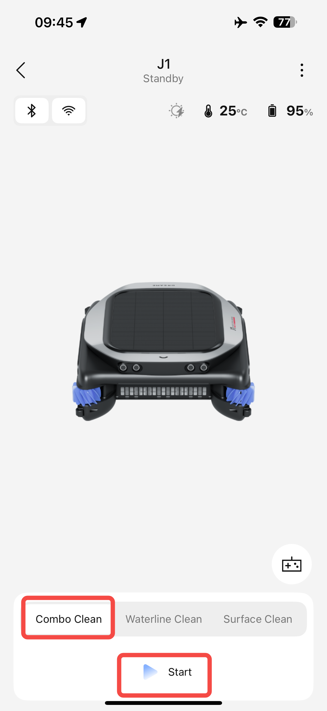
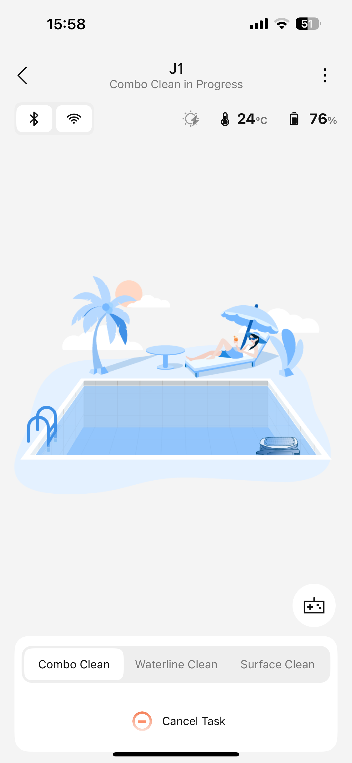
1、启动清洁 Activate the cleaning function.
1、启动组合清洁
Activate Combo Clean

Slide 3
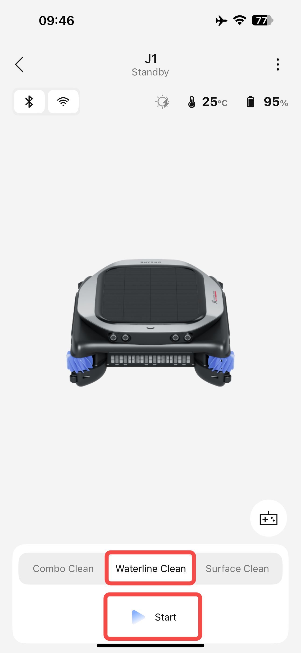
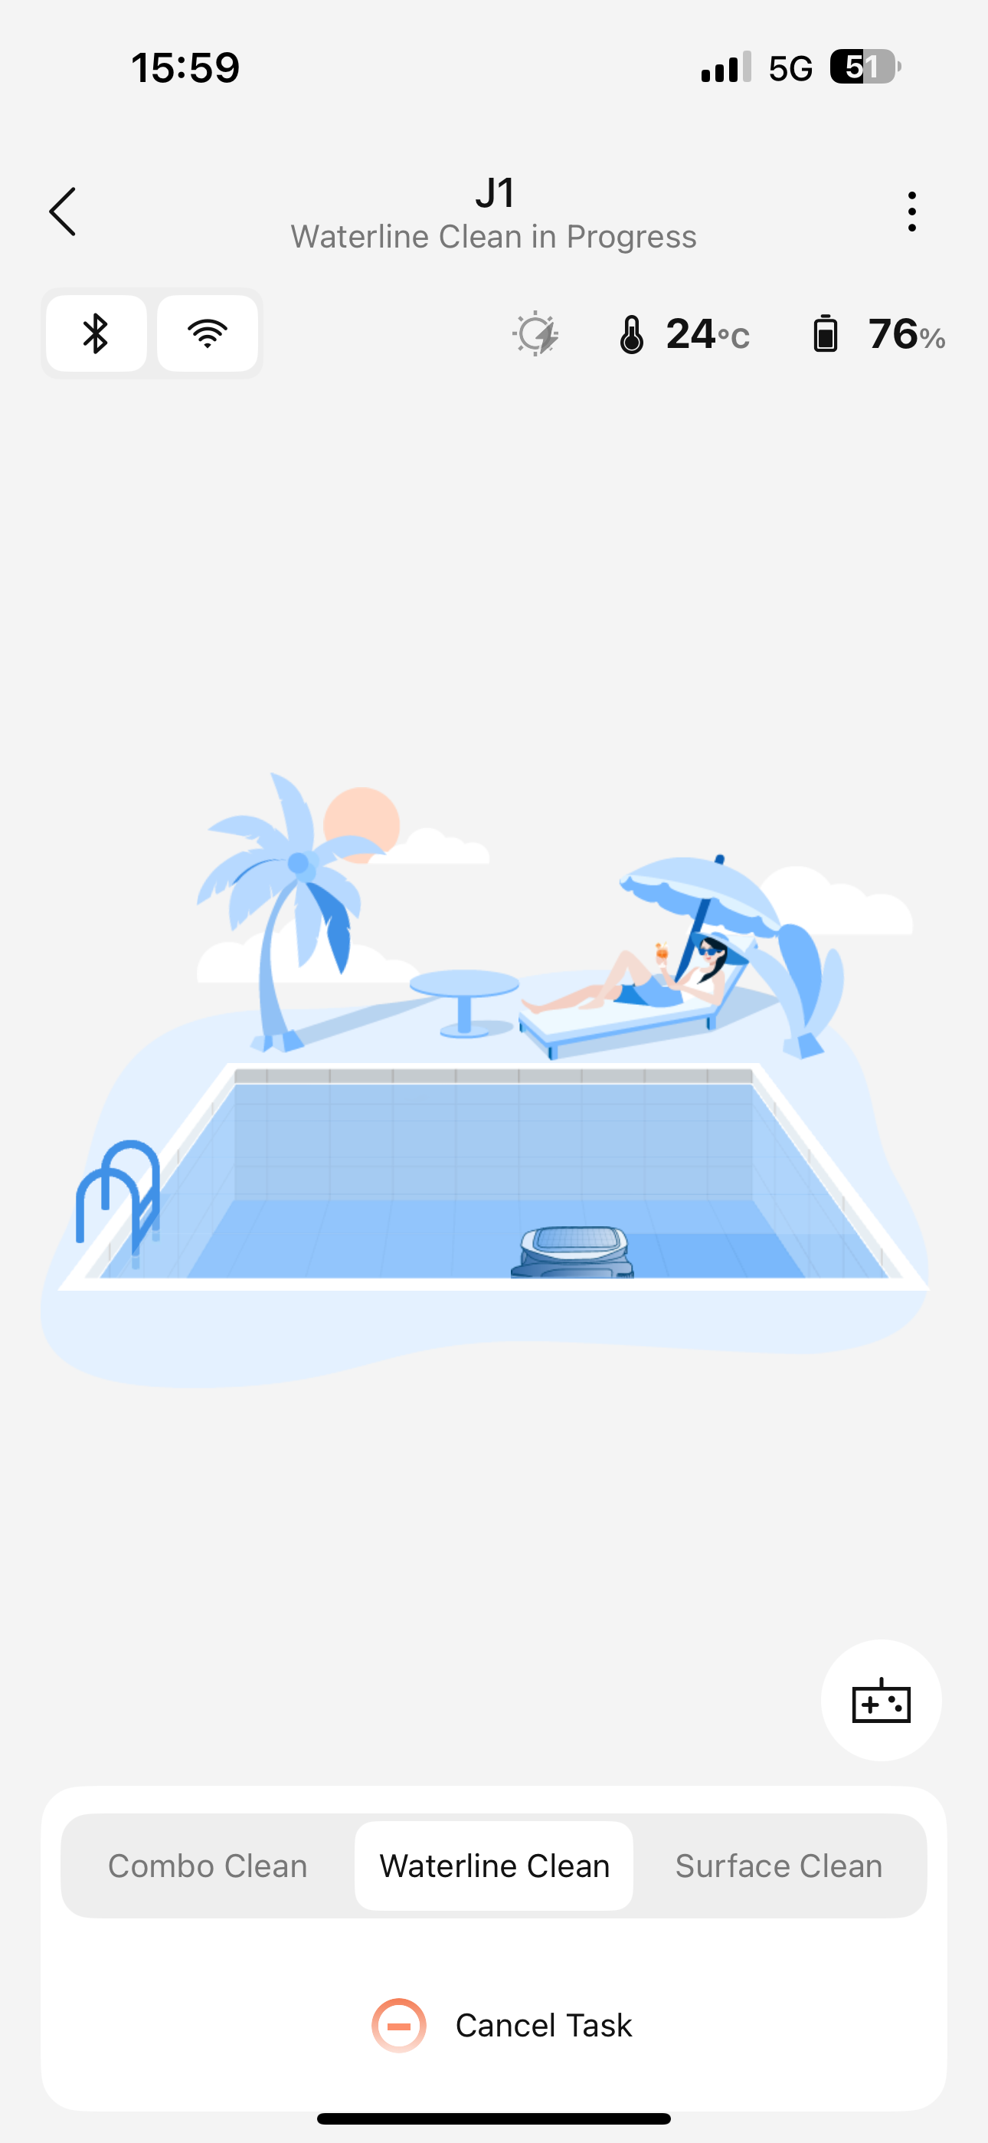
1、启动清洁Activate the cleaning function.
2、启动沿边清洁
Activate Waterline Clean

Slide 4
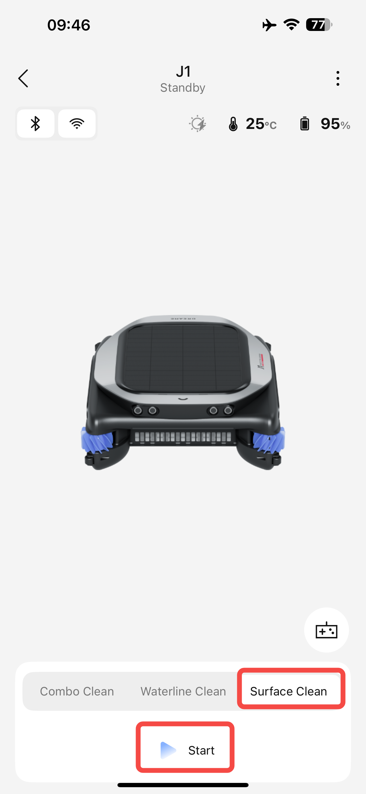
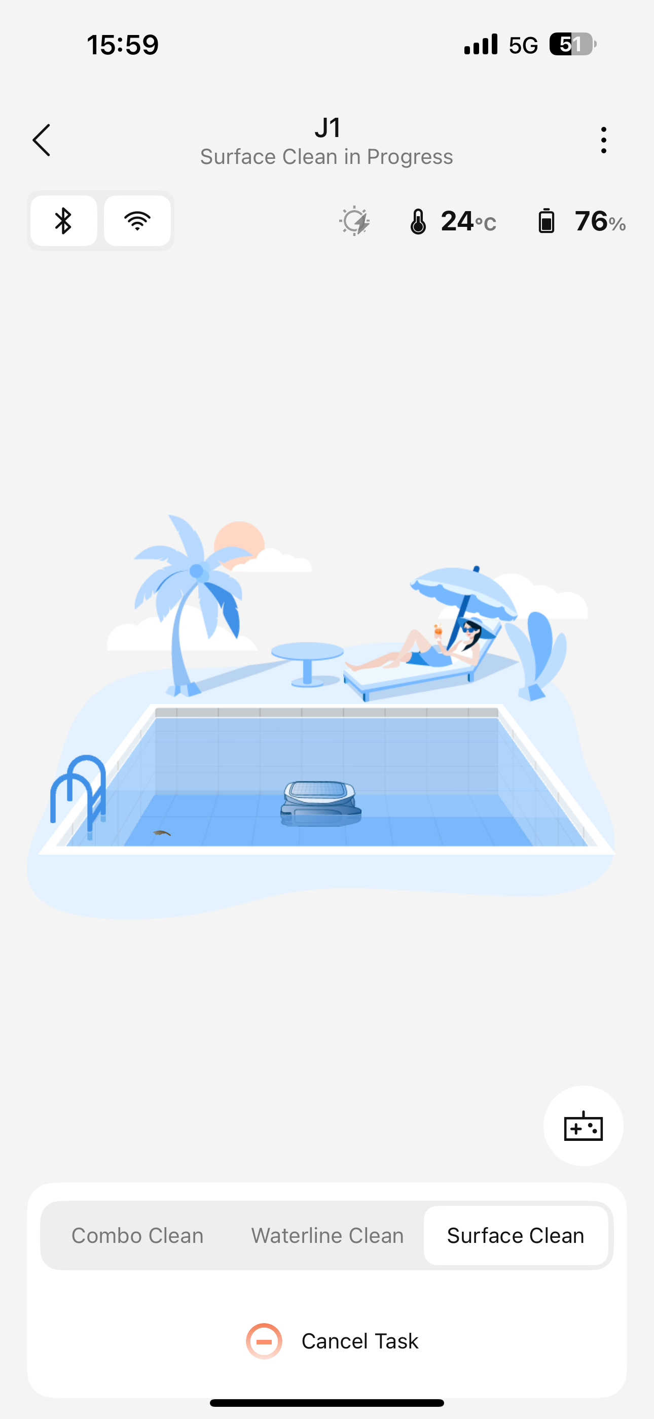
1、启动清洁Activate the cleaning function.
3、启动水面清洁
Activate Surface Clean

Slide 5
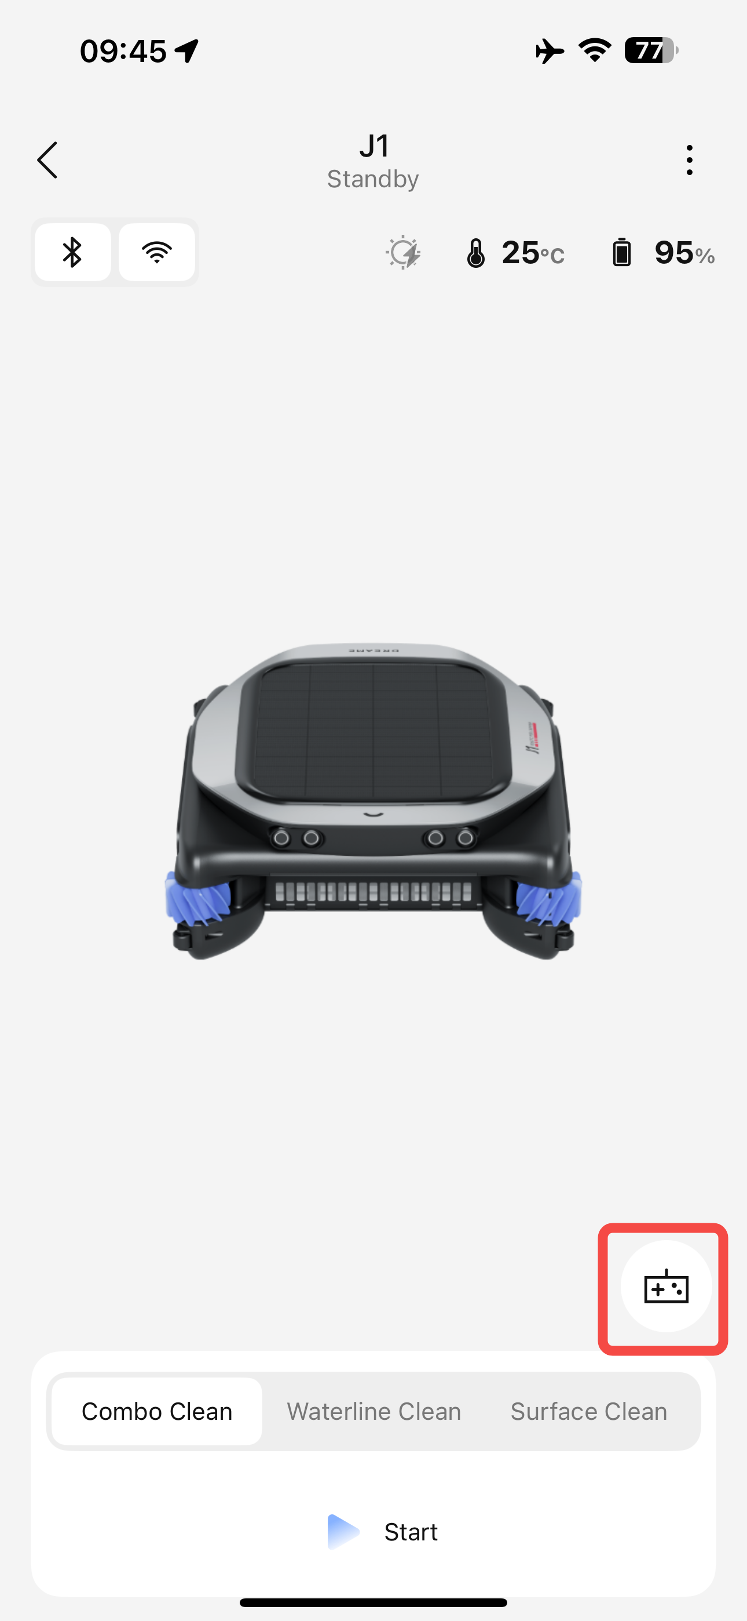
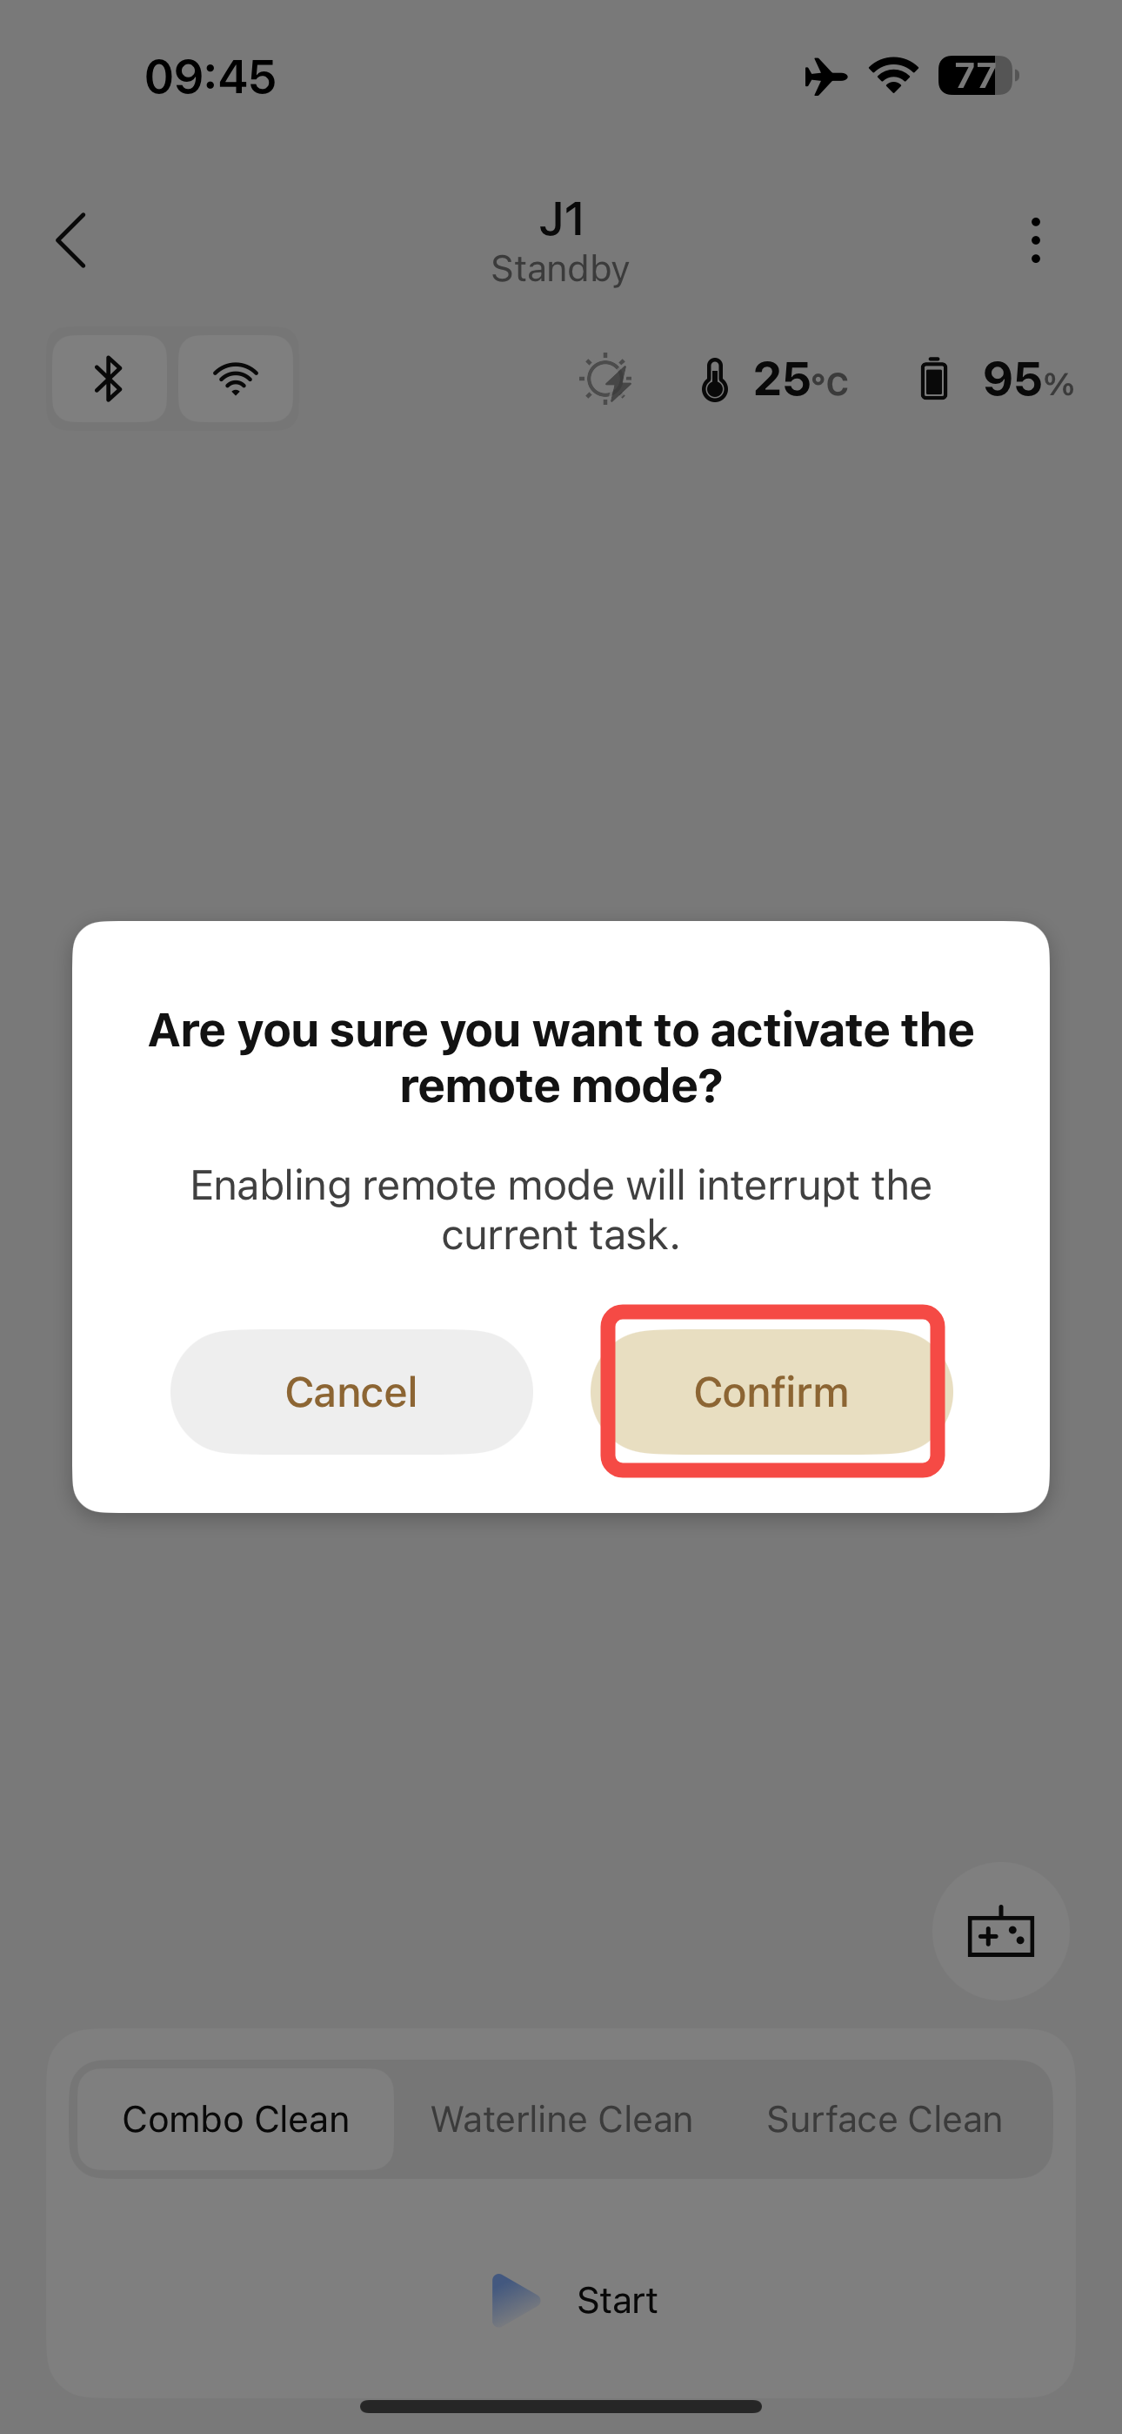
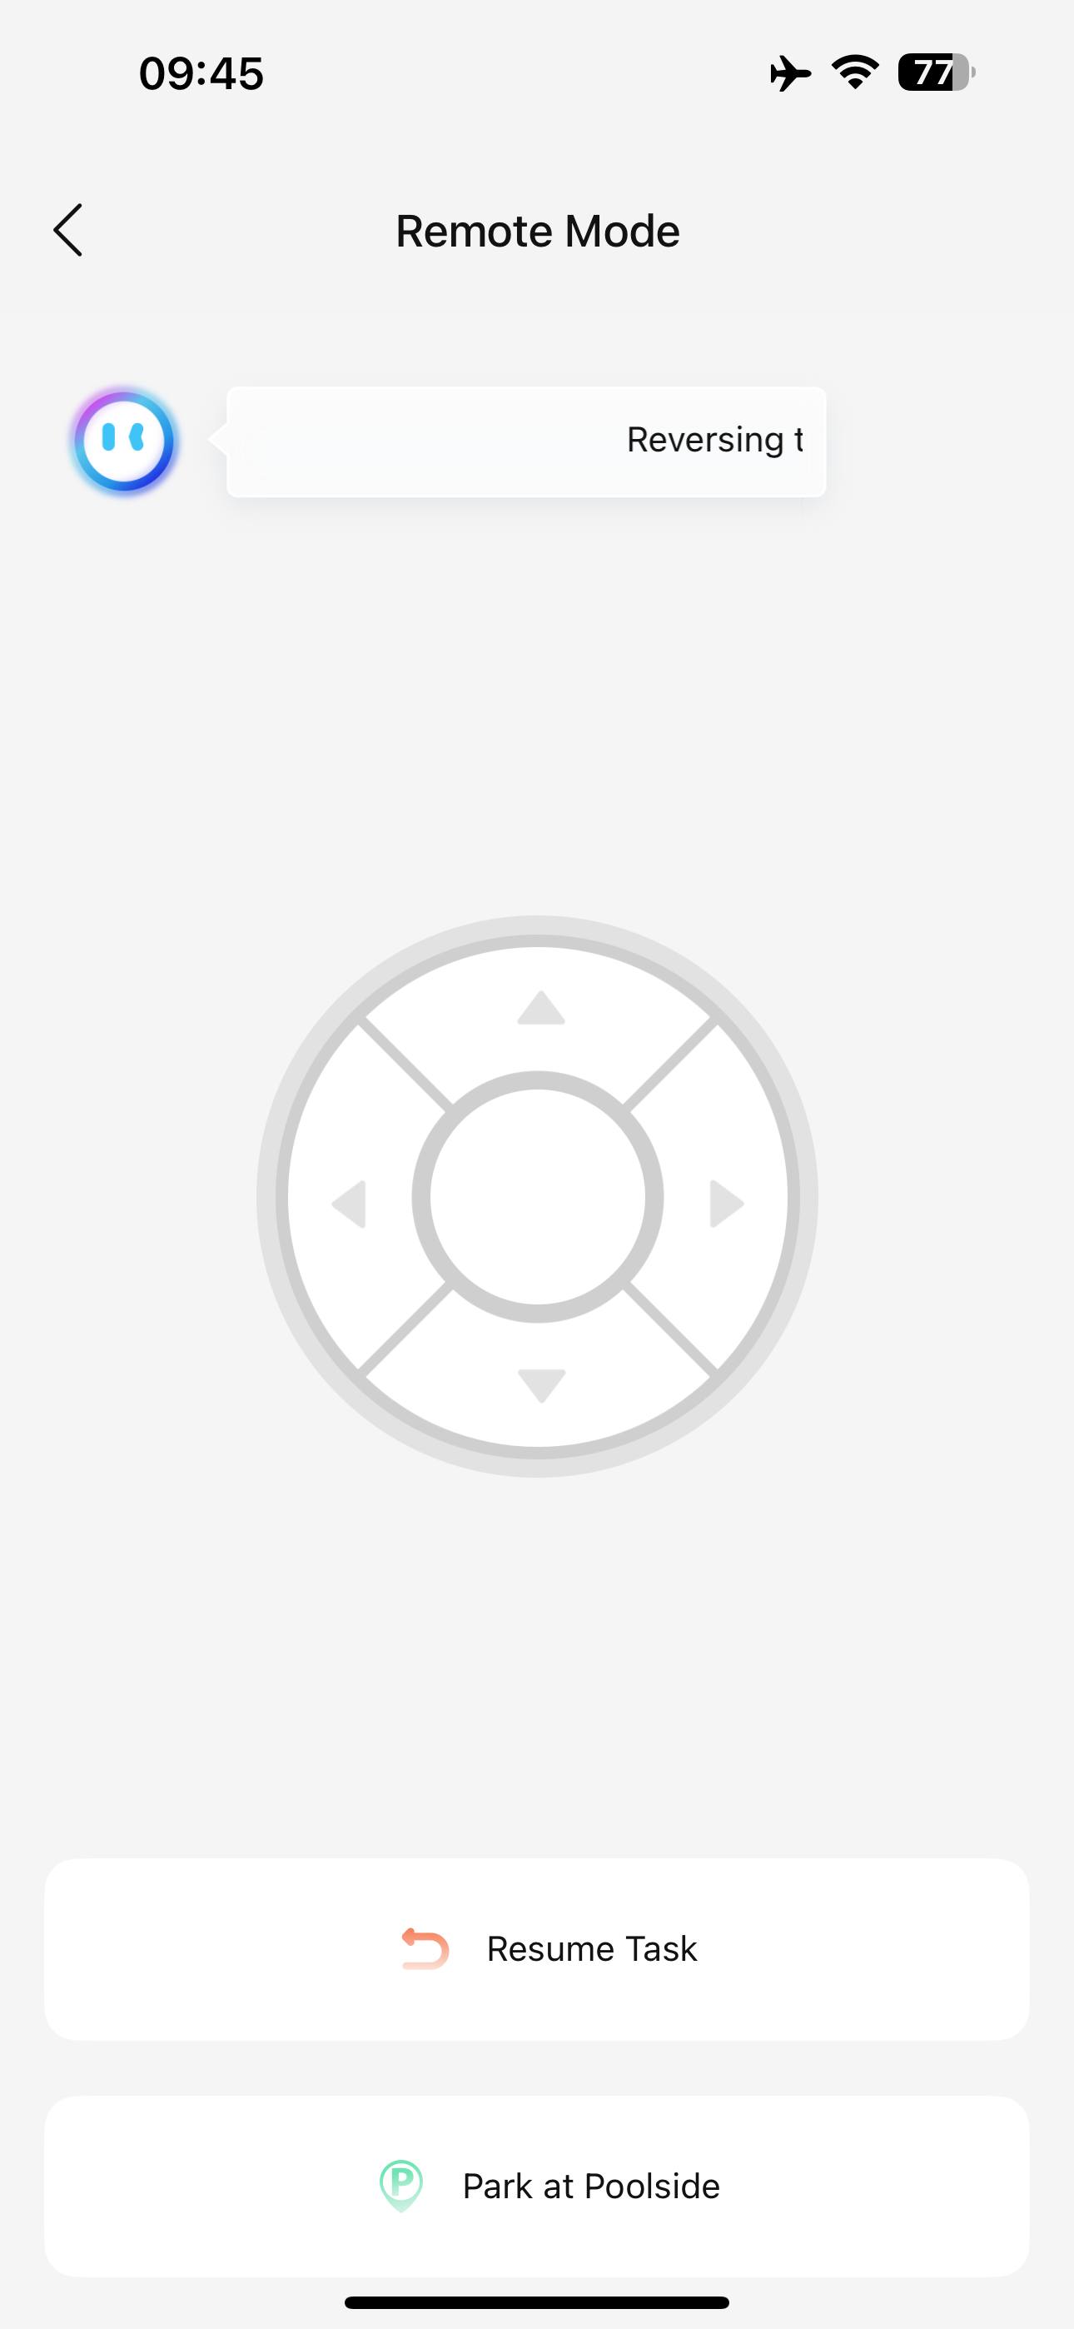
1、启动清洁 Activate the cleaning function.
4、遥控模式
Remote Mode

Slide 6
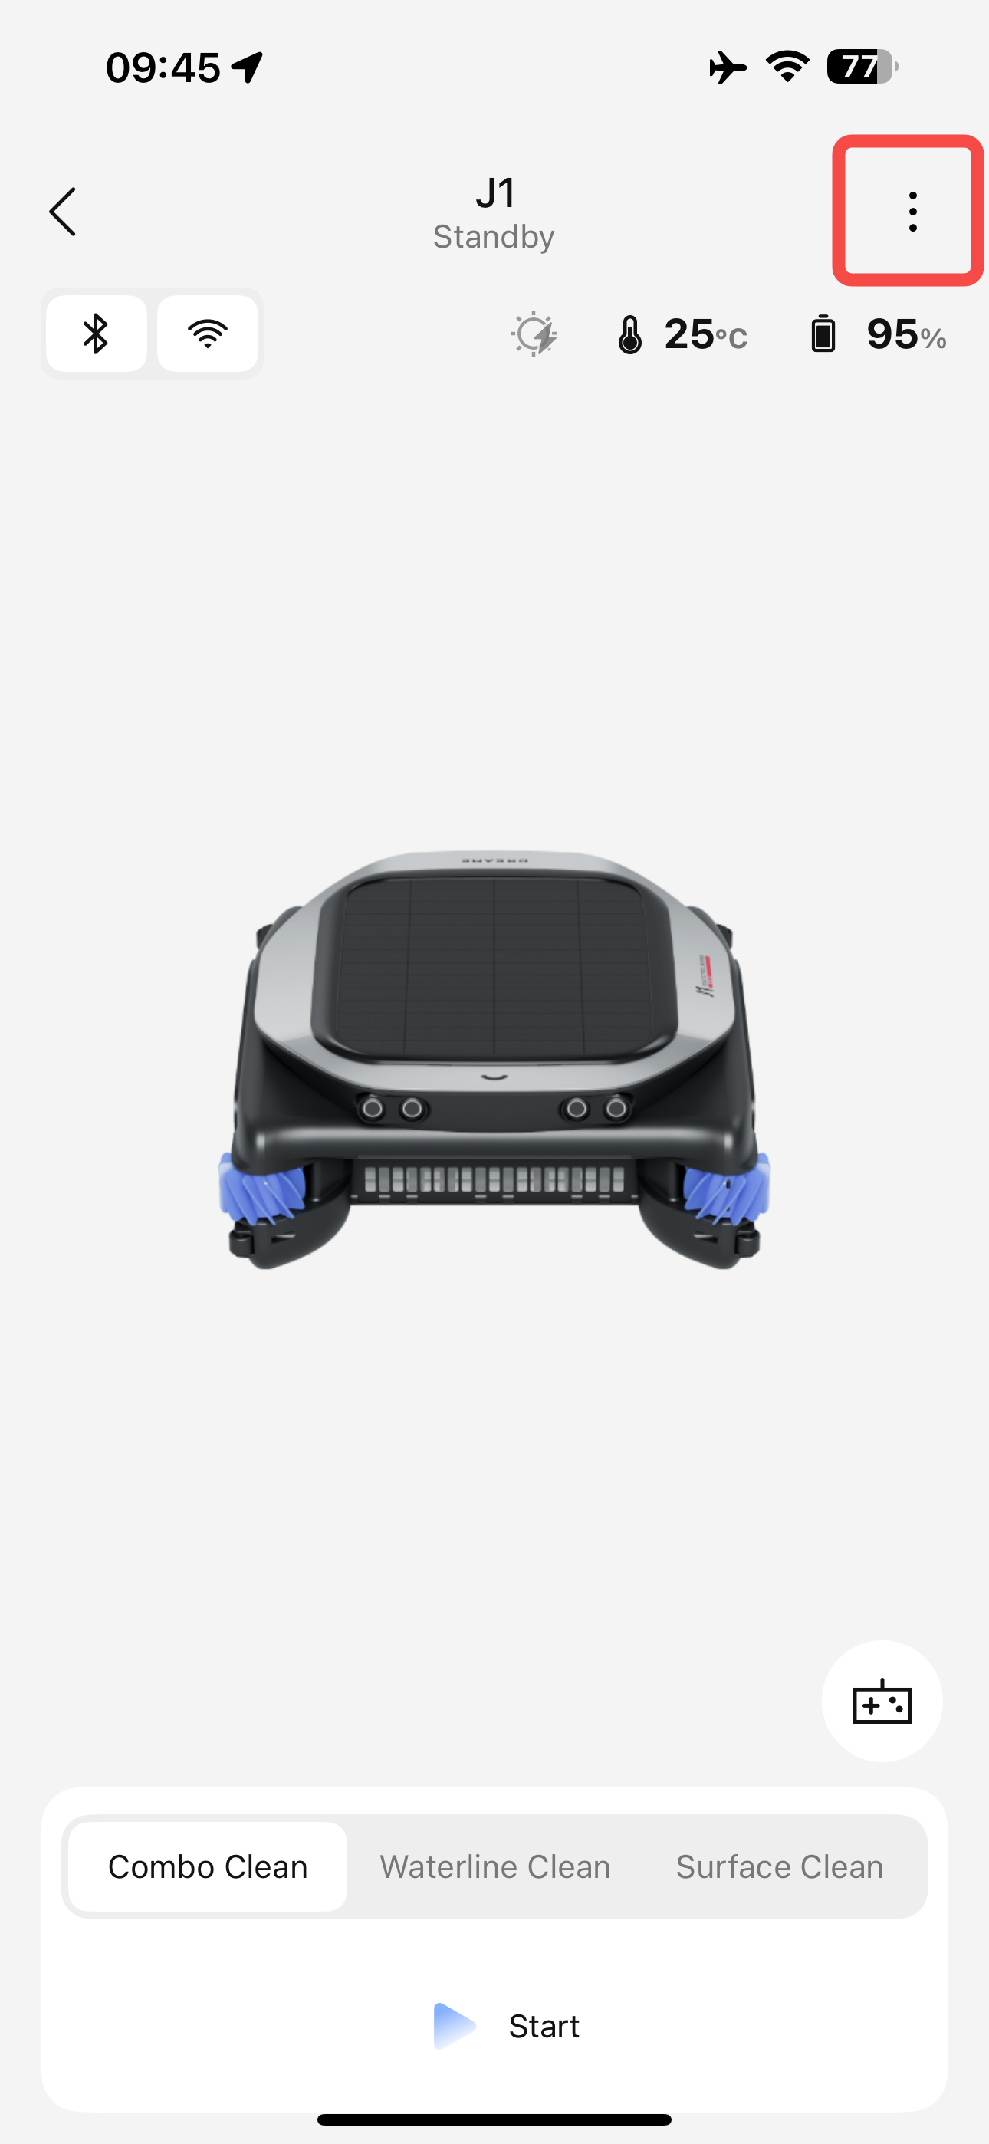
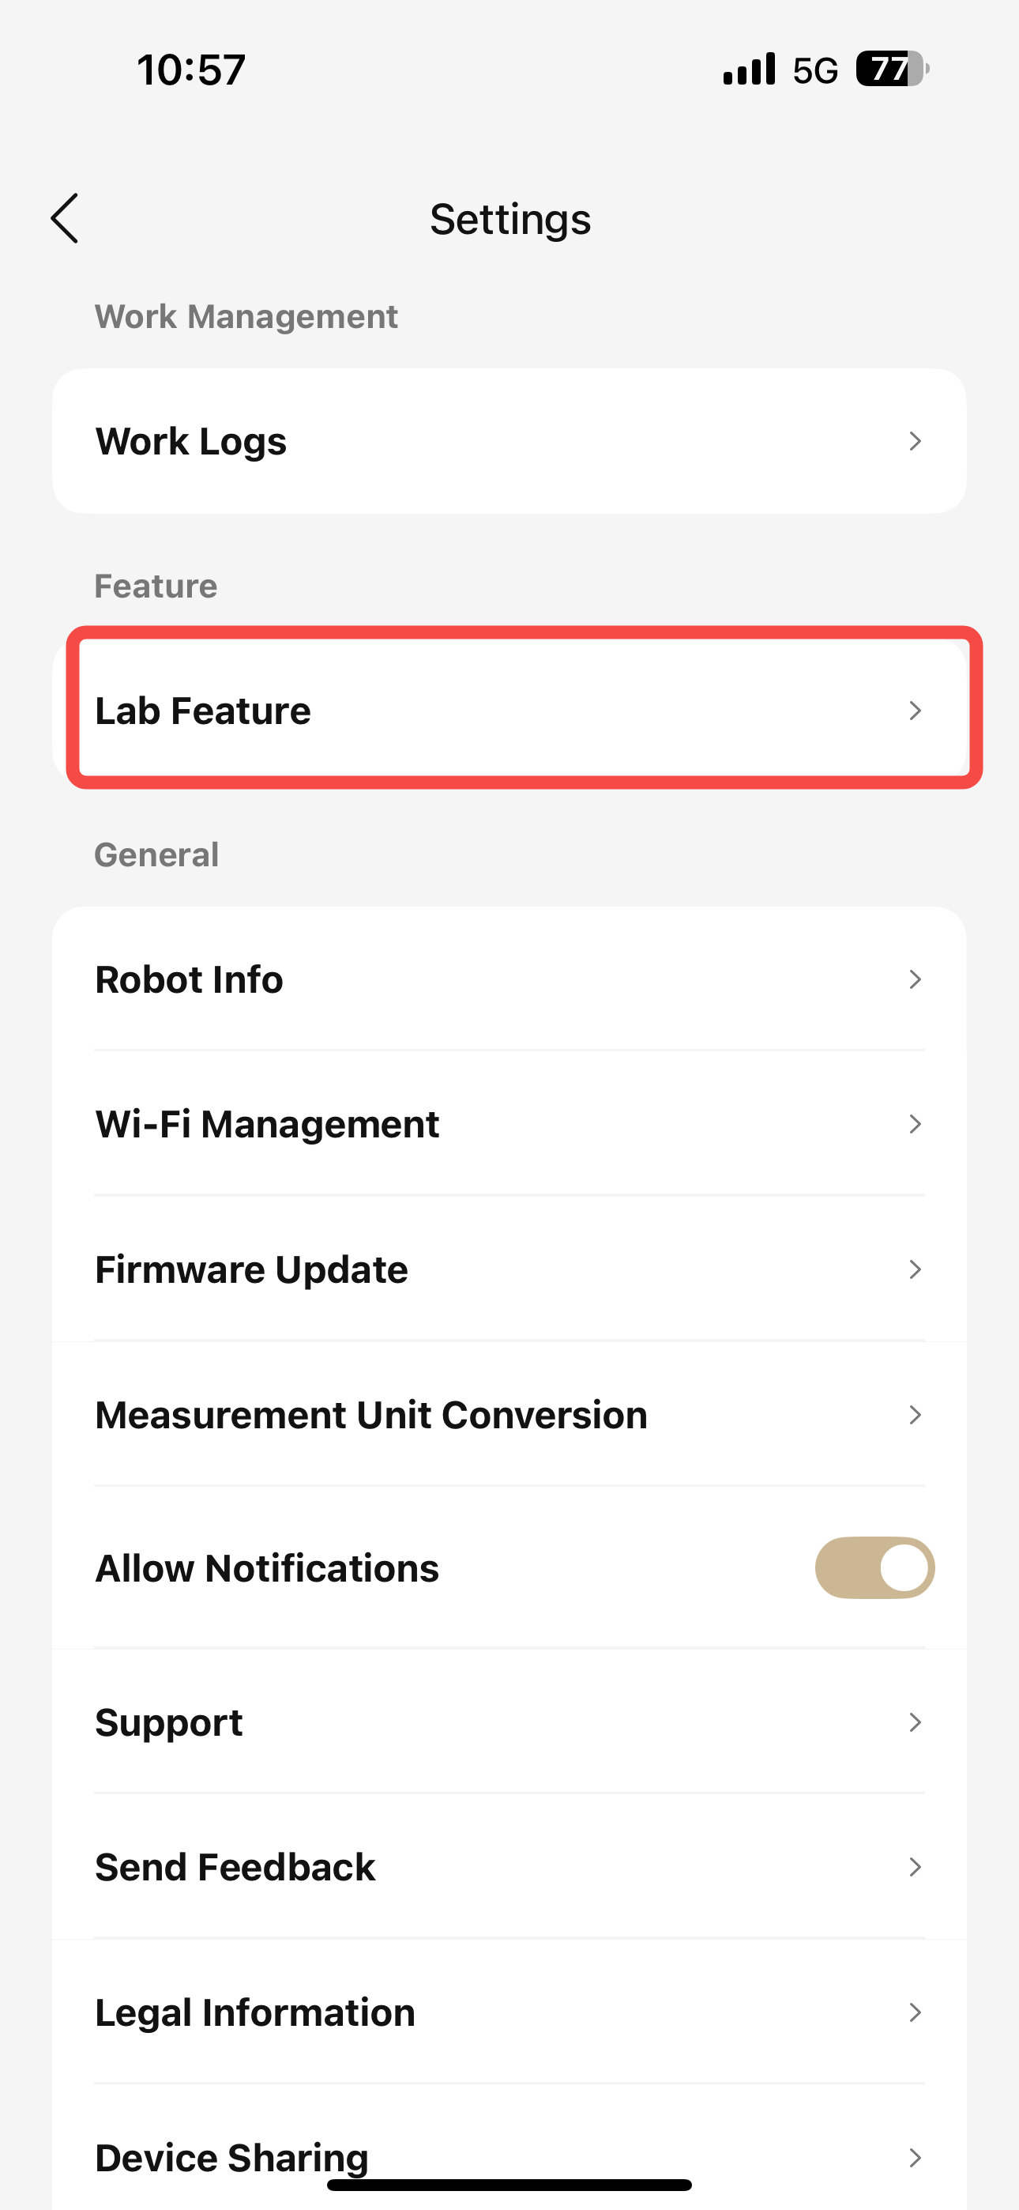
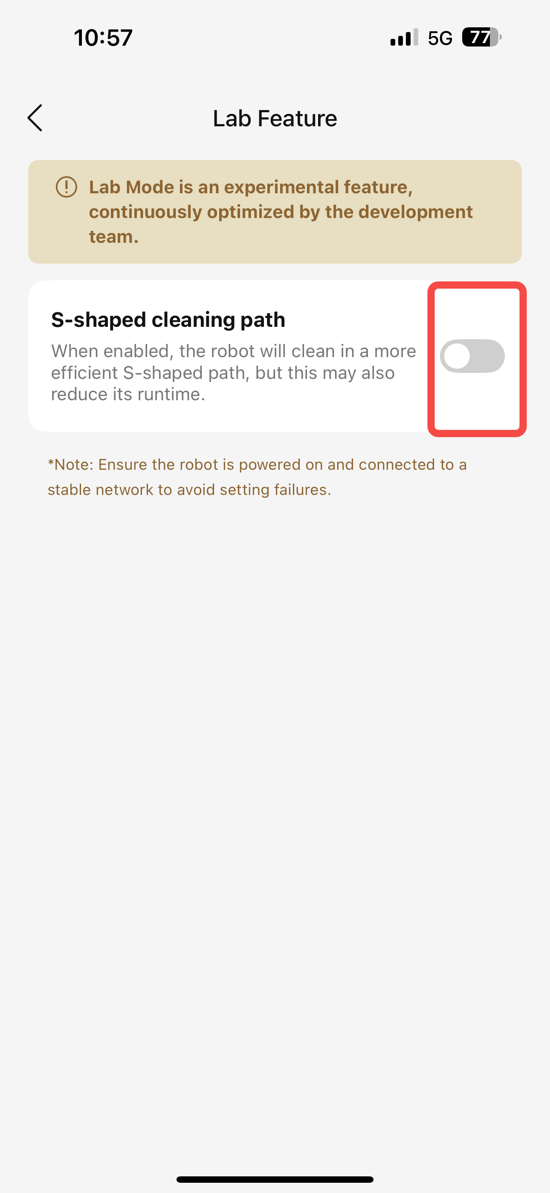
2、功能设置
实验室功能——弓形路径清洁（*注：请在机器开机且有通讯状态下进行设置，否则可能导致设置失败）
开启后，机器人会按照弓形路径开展清洁任务，以提高清洁效率，但同时会增加功耗
Lab Feature——S-shaped cleaning path(*Note: Ensure the robot is powered on and connected to a stable network to avoid setting failures)
When enabled,the robot will clean in a more efficient S-shaped path, but this may also reduce its runtime

Slide 7
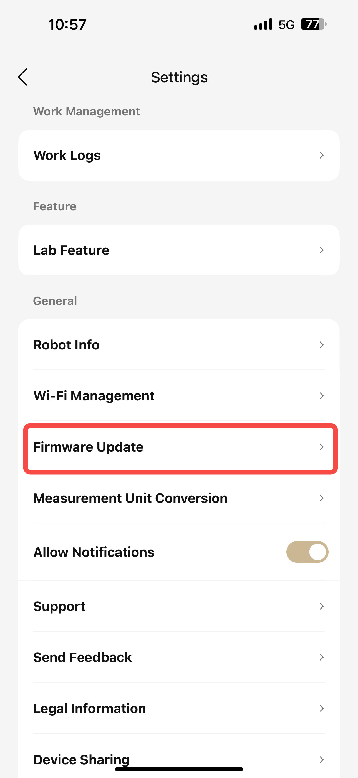
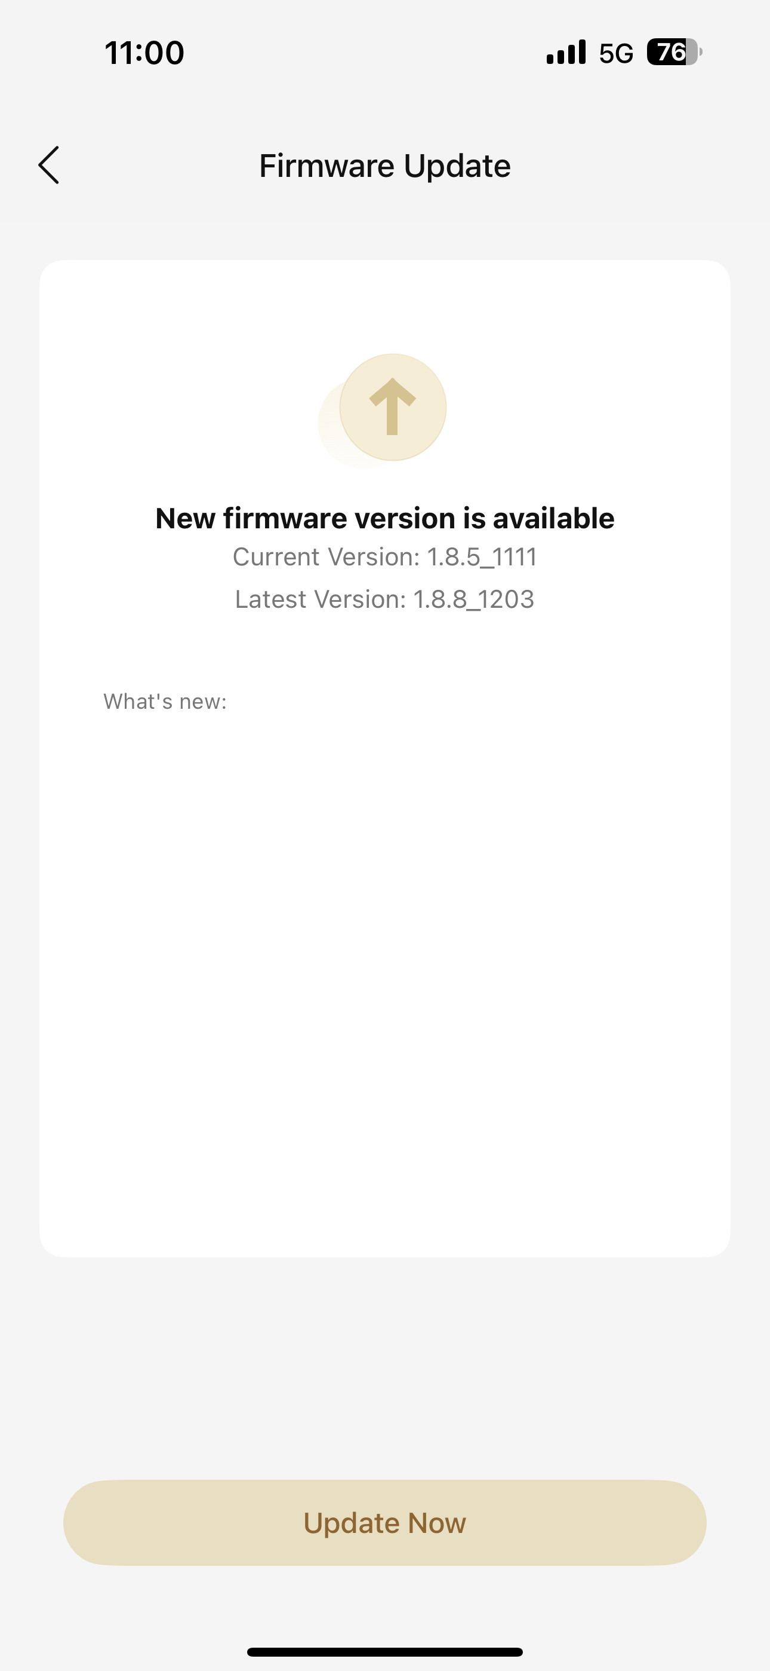
3、固件升级 OTA
升级最新固件版本 Upgrade to the latest firmware version

Slide 8
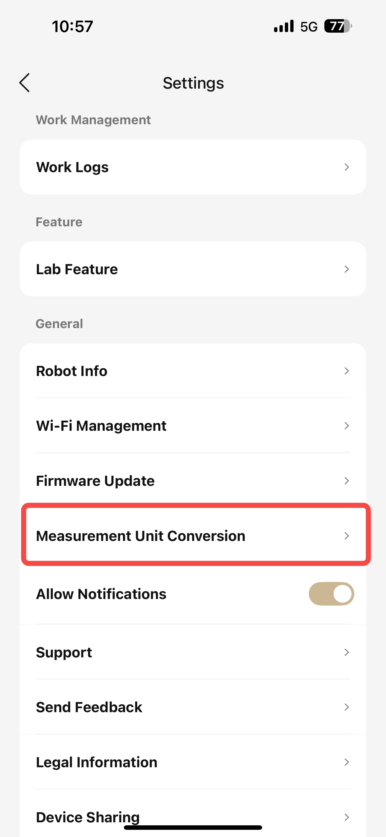
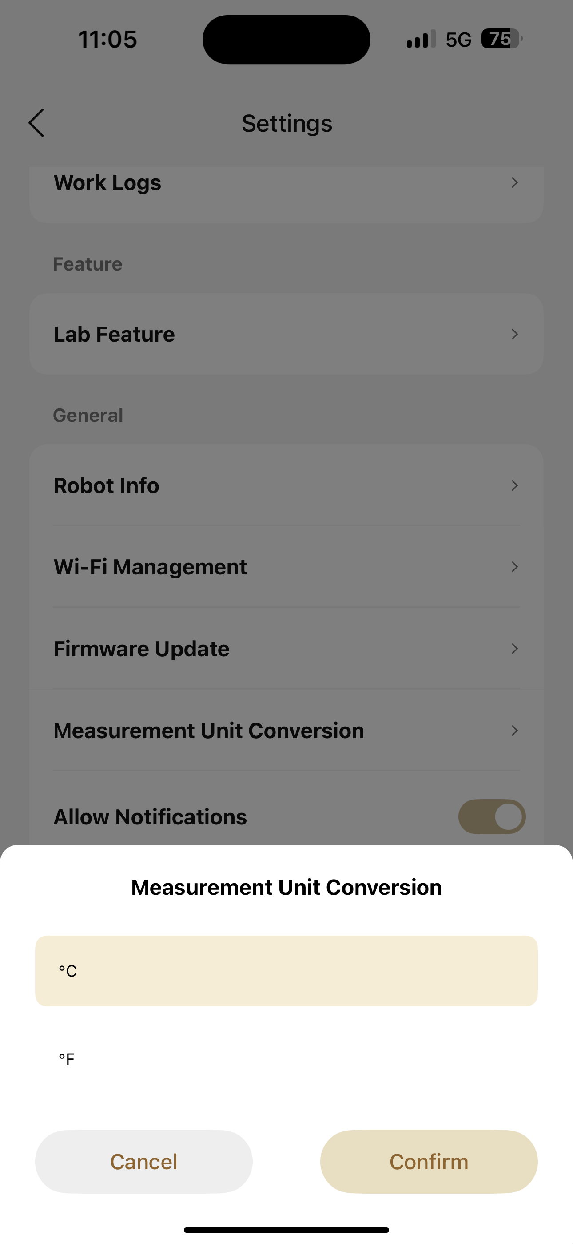
4、单位转换Unit conversion
更换显示温度单位

Slide 9
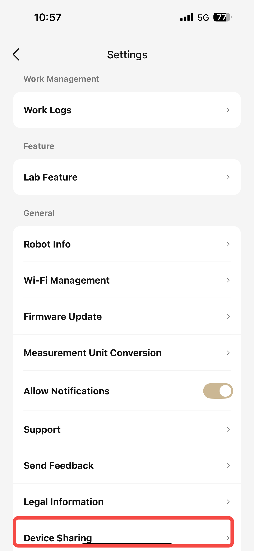
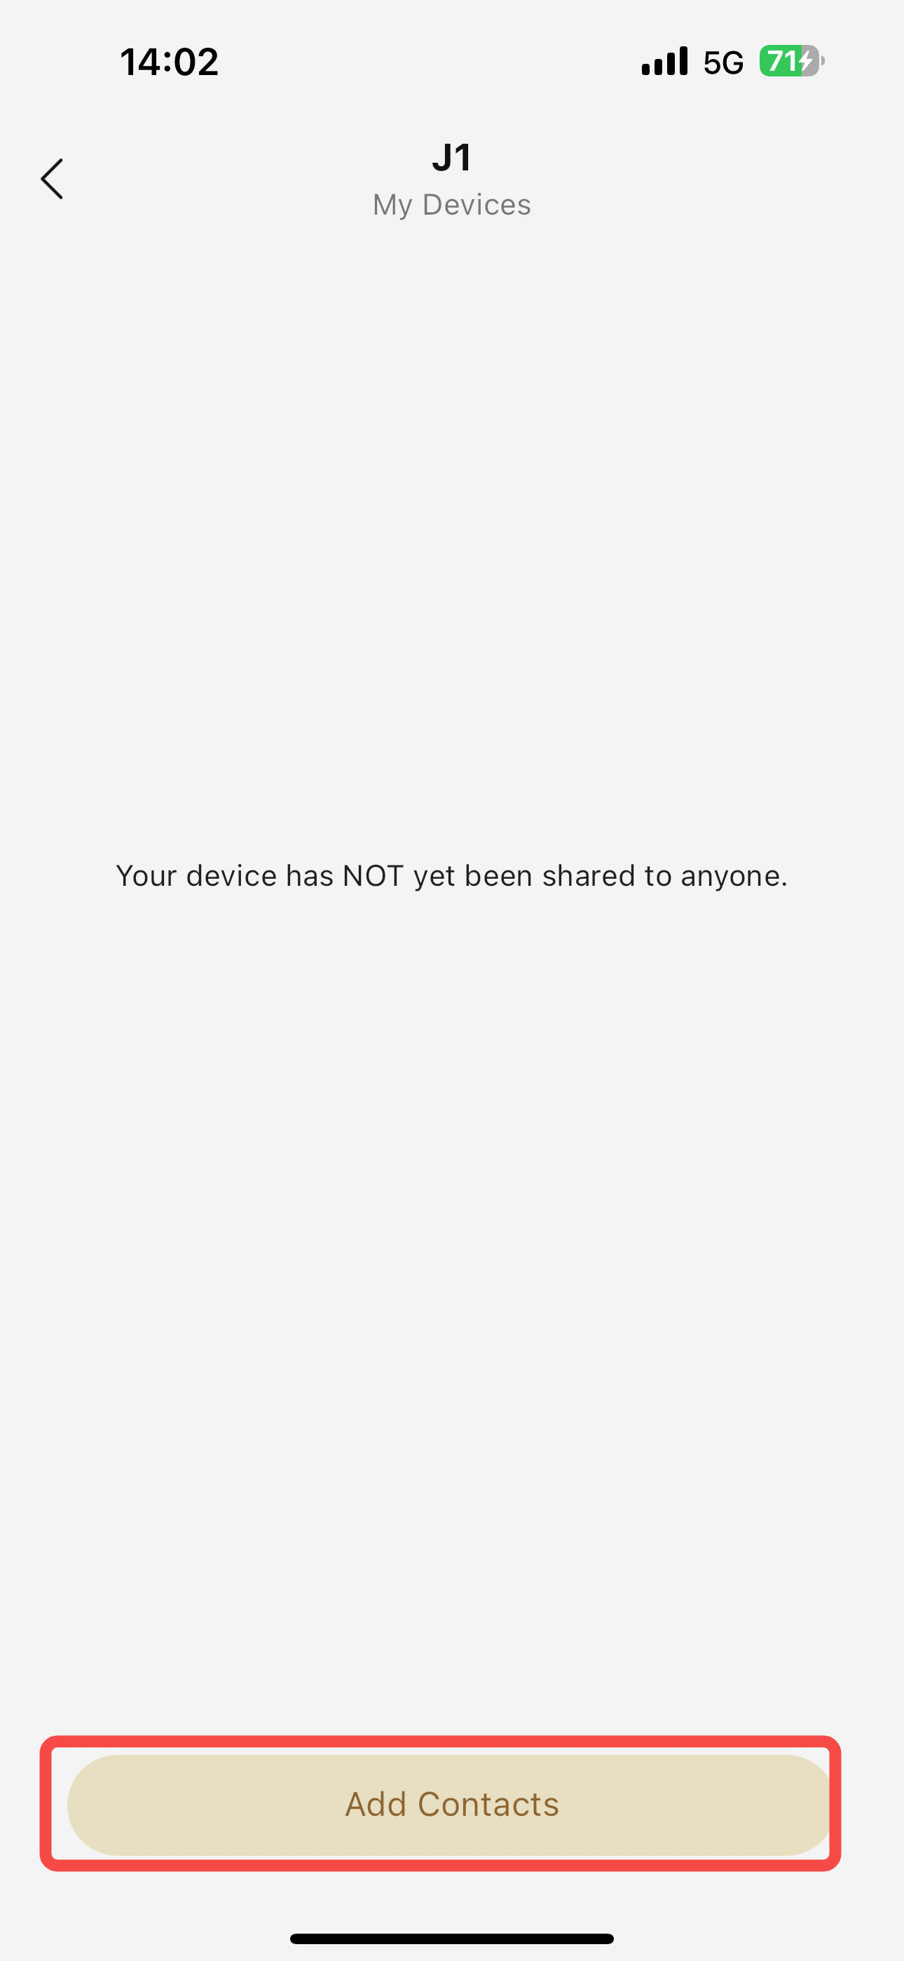
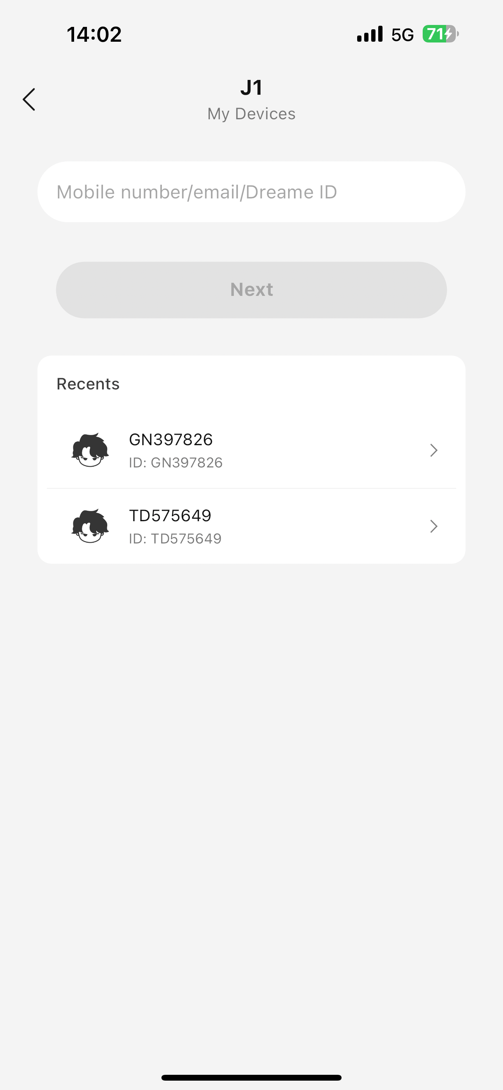
5、共享设备Shared device
将设备共享给家人或朋友 Share your device with family or friends

Slide 10
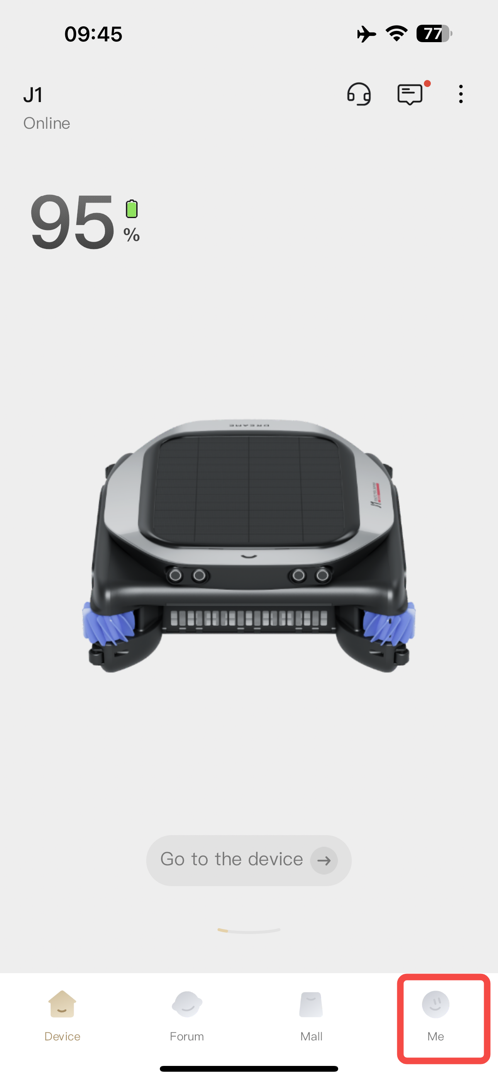
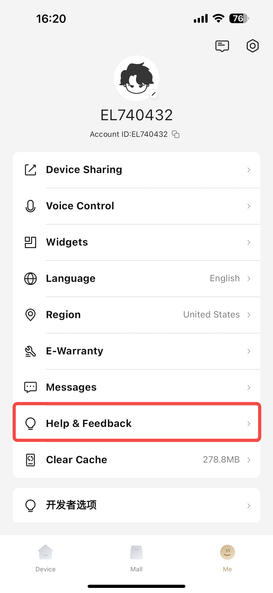
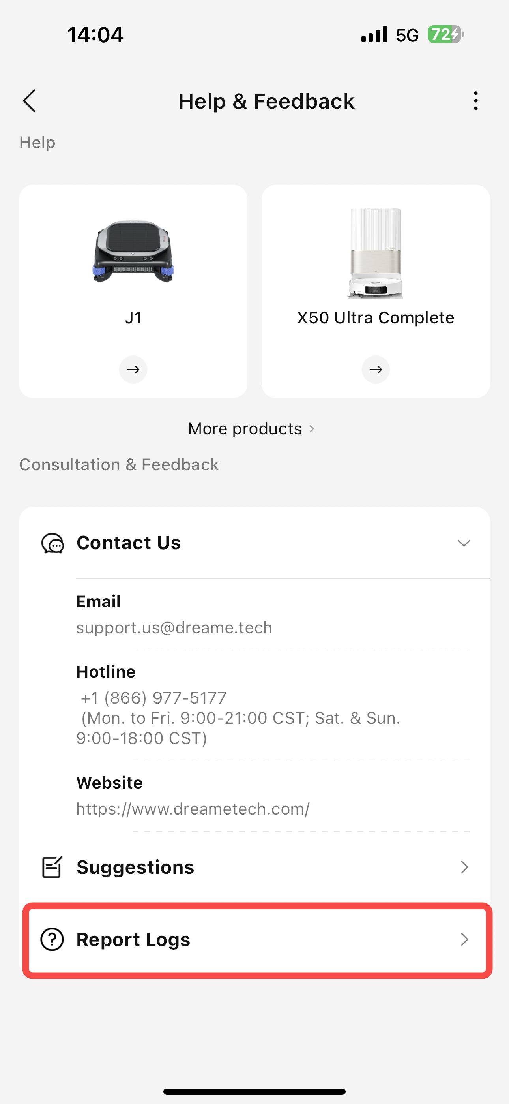
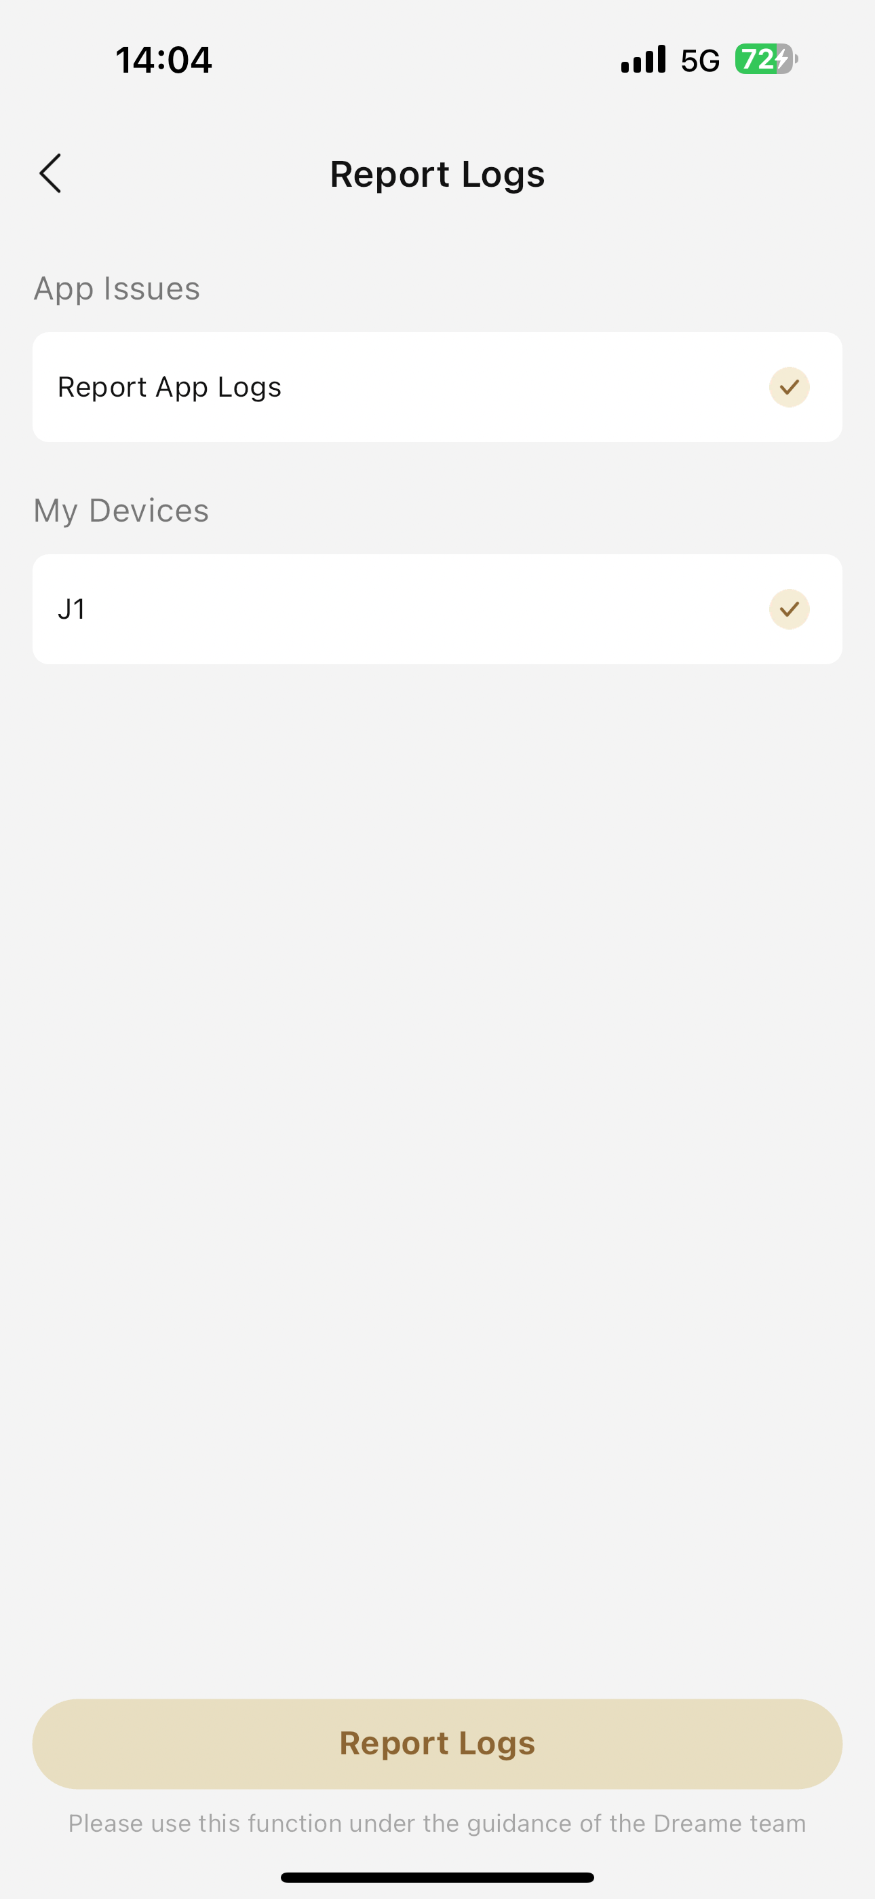
日志上传 Report Logs
在APP-我-帮助与反馈-报告log中，选择设备以及APP的日志，点击上传
In the app, go to Me - Help & Feedback - Report Log, select the device and the app's log, then click Upload.
Notes:
单击此处添加文本

Slide 11
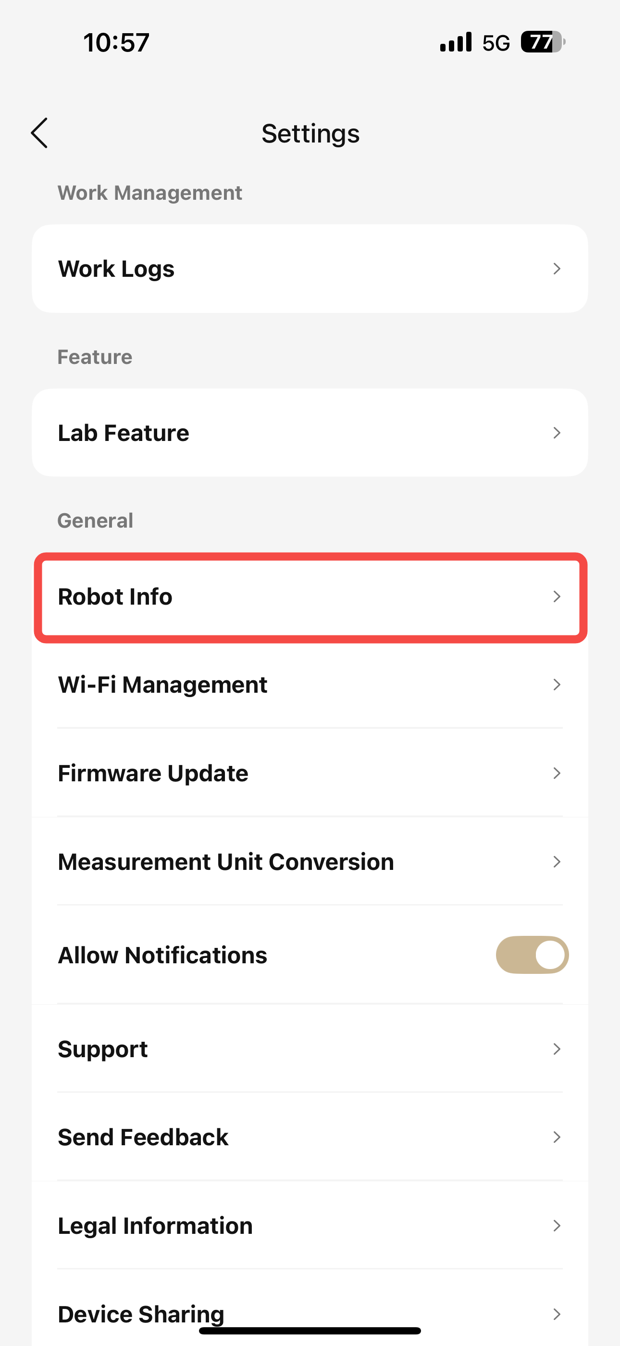
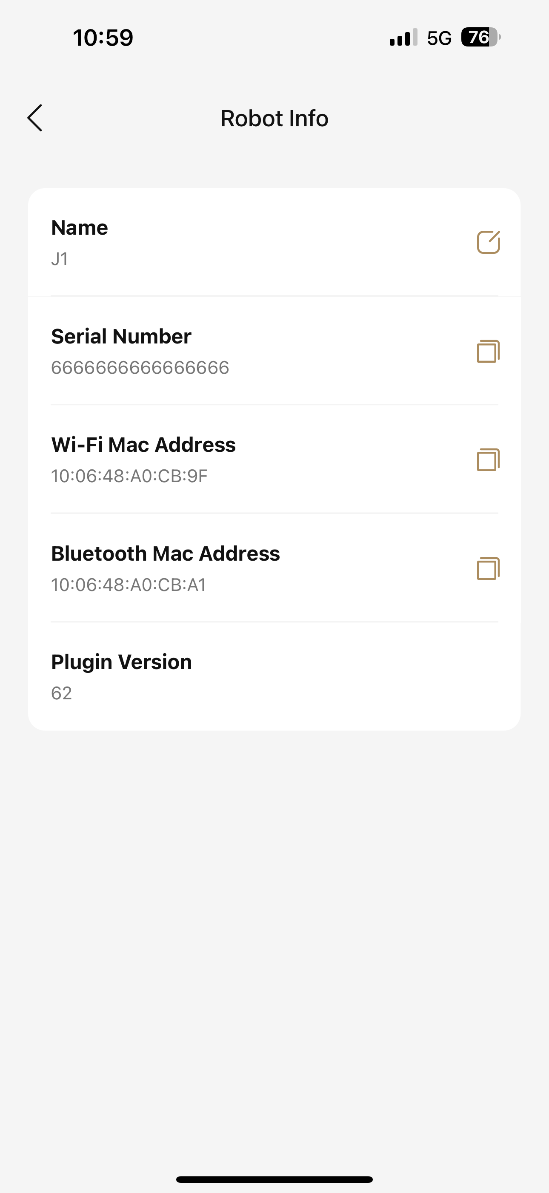
查询SN
在APP-机器人页面-菜单栏-机器人信息-SN
In APP- Robot page - Menu bar - Robot information -SN
Notes:
单击此处添加文本

Slide 12
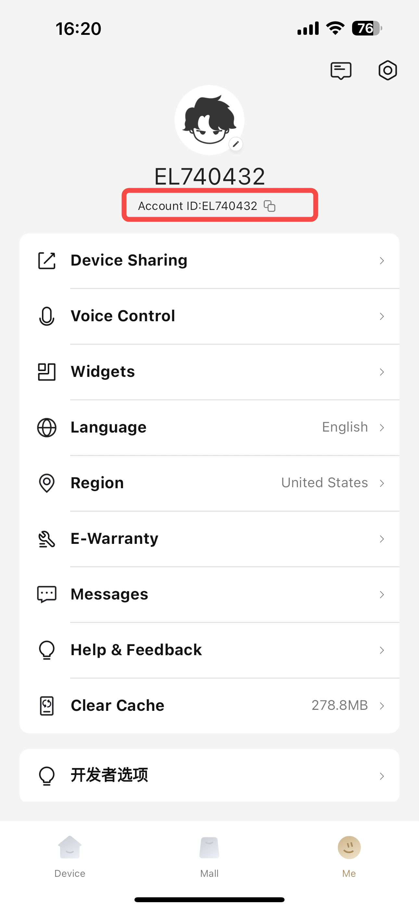
查询UID
在APP-我
In the app, go to Me
Notes:
单击此处添加文本

